Slide 1
On the Impact of Aspectual Decompositions on Design Stability: An Empirical Study
Phil Greenwood
p.greenwood@lancaster.ac.uk
  Co-authors: Thiago Bartolomei, Eduardo Figueiredo, Marcos Dosea, Alessandro Garcia, Nelio Cacho, Claudio Sant’Anna, Sergio Soares, Paulo Borba, Uira Kulesza and Awais Rashid.

Slide 2
Motivation & Aims
Proponents of AO argue that improved changeability is achieved through new composition mechanisms.
Stability is often dependent on the decomposition mechanism.
  OO and multiple inheritance.
No studies on the ability of AO to promote stability.
  Other studies focused on upfront modularisation of concerns.
  No empirical knowledge on the affects on ripple-effects.
  Multi-dimensional analysis.
Notes:
Multi-dimensional analysis
modularity sustenance
ripple effects
satisfaction of basic design principles

Slide 3
Experiment Design
Selected the Health Watcher System.
  Web-based information system.
  +5000 lines of code, +100 modules.
  Designed with modularity and changeability in mind.
Implementation of change scenarios (x9)
  Perfective, corrective, refactoring, additive.
Assessment Process
  Analyse change of modularity metrics.
  Change impact and stability measures.
Notes:
Demonstrates richness of crosscutting and non-crosscutting concerns.
Highlight criteria establish when selecting HealthWatcher:
Established a weighted list of desirable criteria.
AO and OO implementation.
Paradigm neutral.
System generality.
Real and non-trivial.
Heterogeneous types of concern interactions.
Wide variety of crosscutting and non-crosscutting concerns.
Elegance of the AO and non-AO decompositions.

Slide 4
Modularity Stability
Metrics
CDC
Concern Diffusion over Components
Attributes
CDO
Concern Diffusion over Operations
Separation of Concerns
CDLOC
Concern Diffusion over LOC
LOC
Lines of Code
Size
NOA
Number of Attributes
WOC
Weighted Operations per Component
Coupling
Vocabulary Size
VS
Cohesion
CBC
Coupling between Components
NoC
Number of Children
LCOO
Lack of Cohesion in Operations

Slide 5
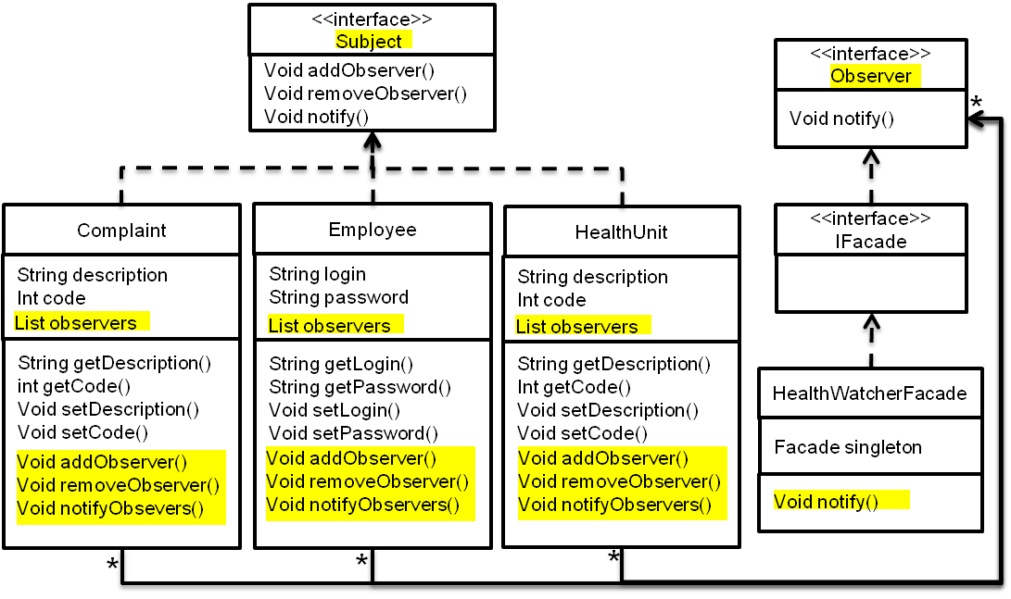
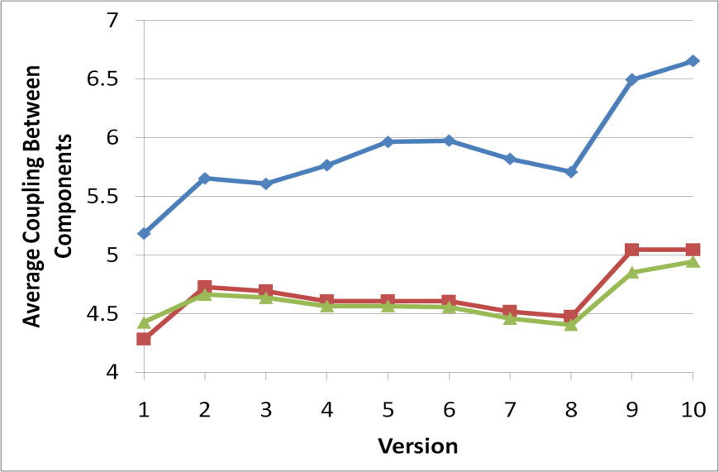
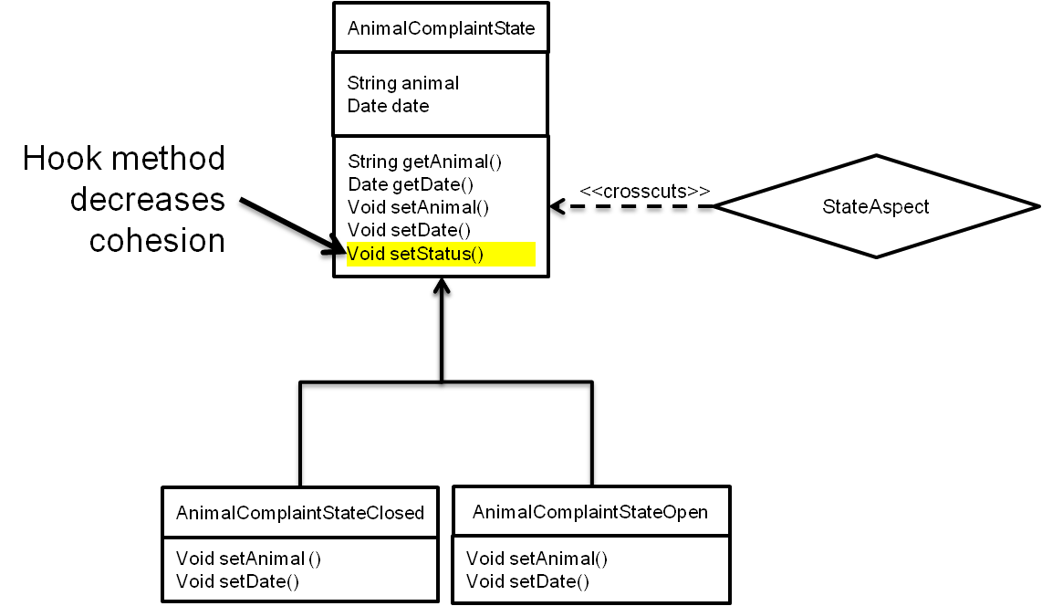
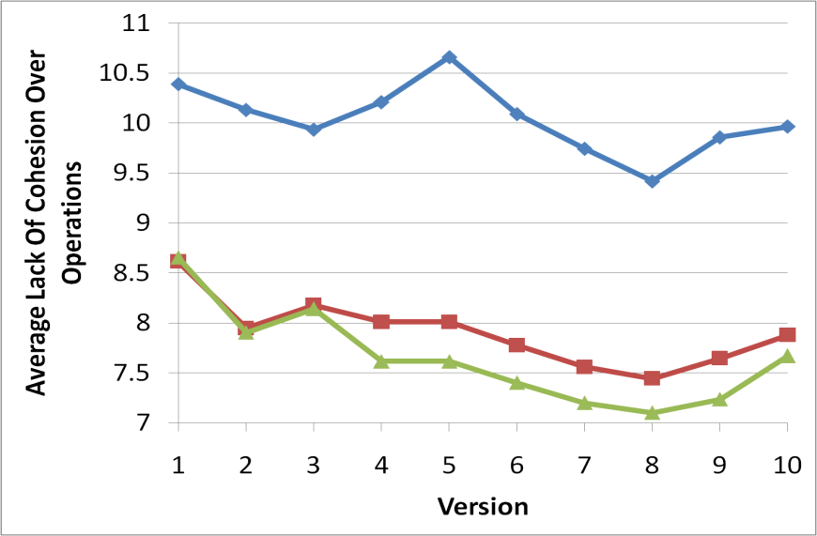
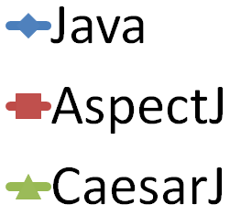
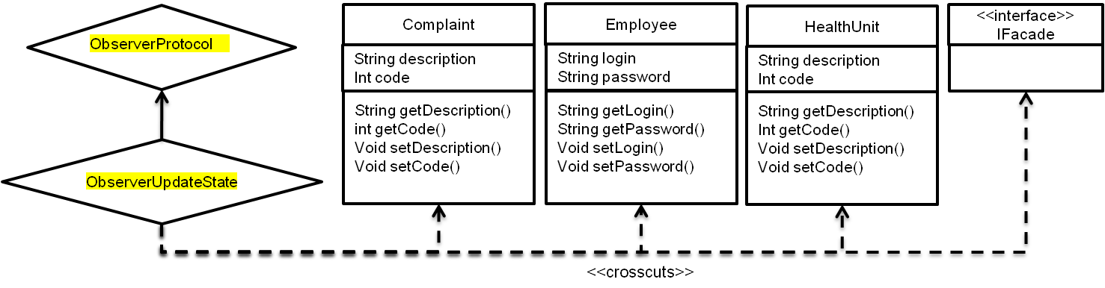
Does AOP stabilise coupling and cohesion?
Better coupling and cohesion in AO.
Need to avoid unnecessary changes to the base code.
Apply AO software artefacts in a disciplined manner.

Slide 6
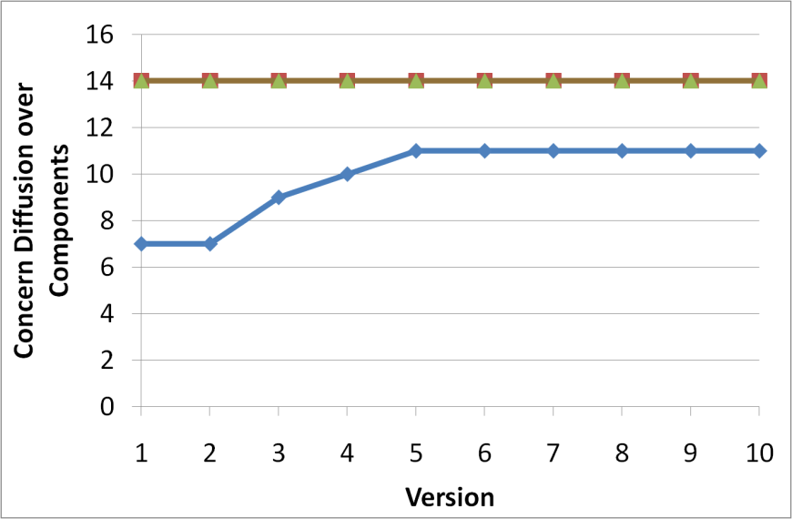
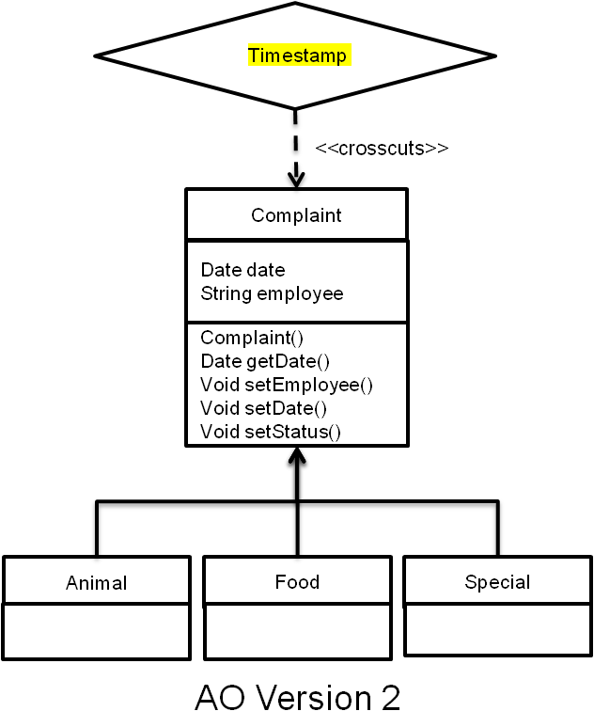
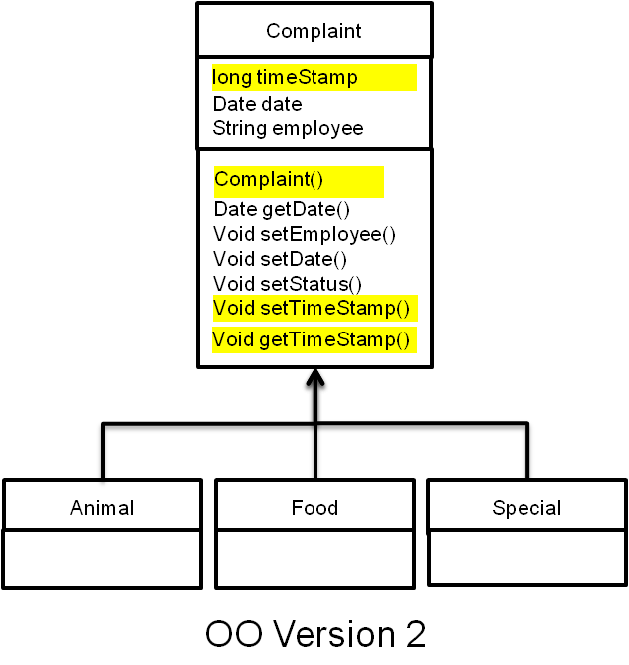
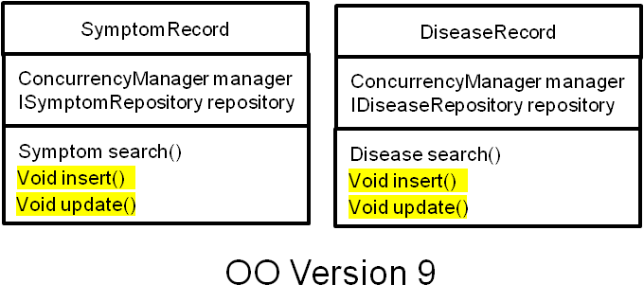
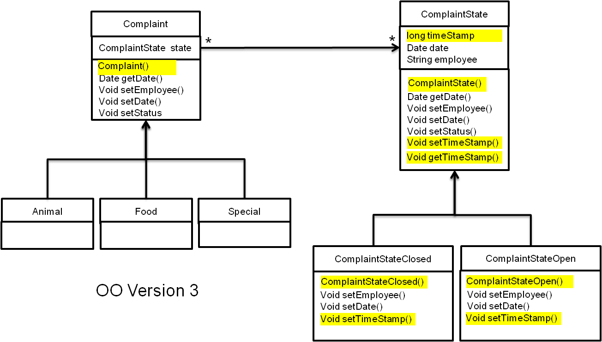
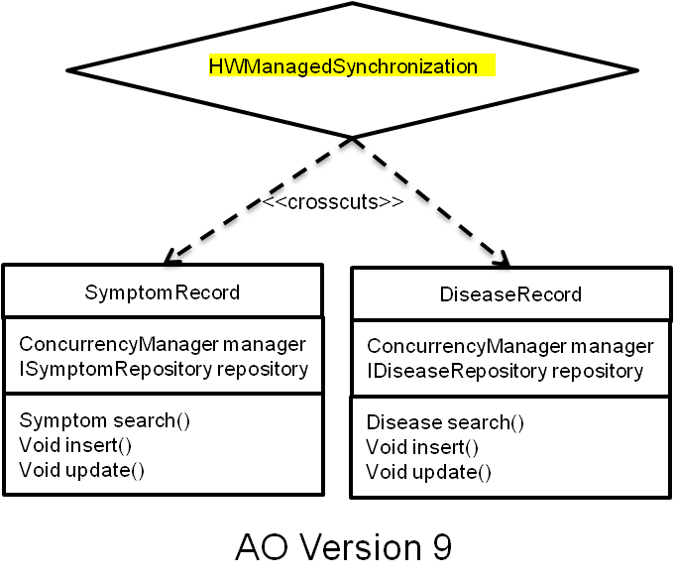
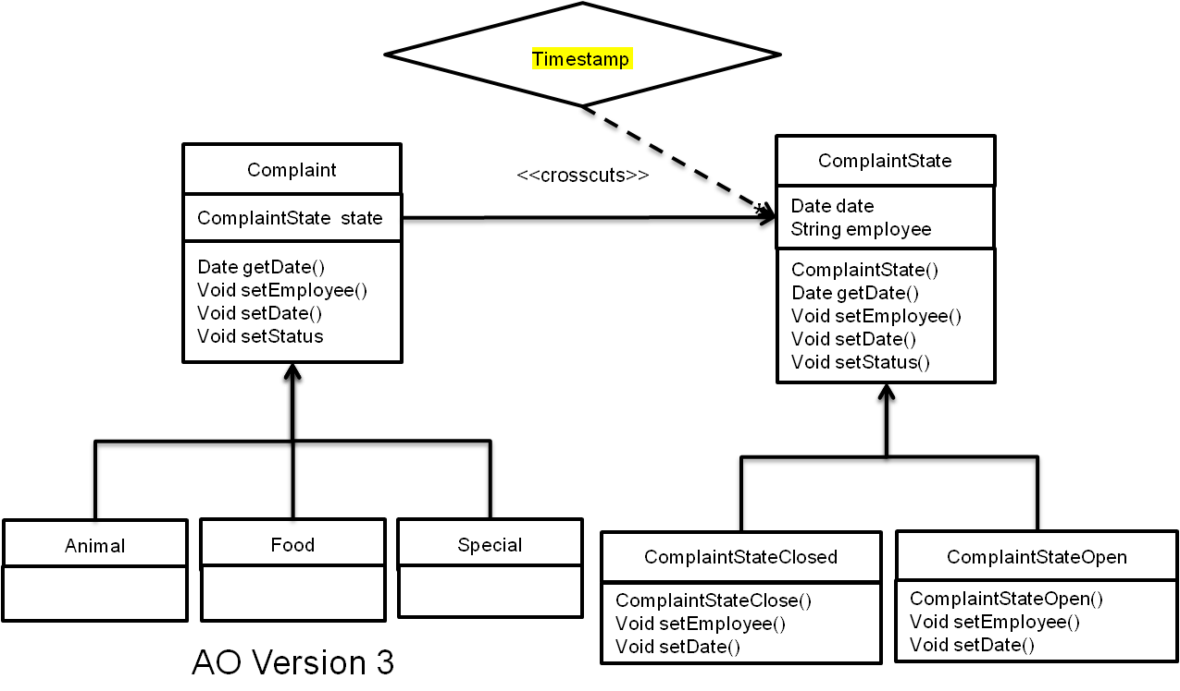
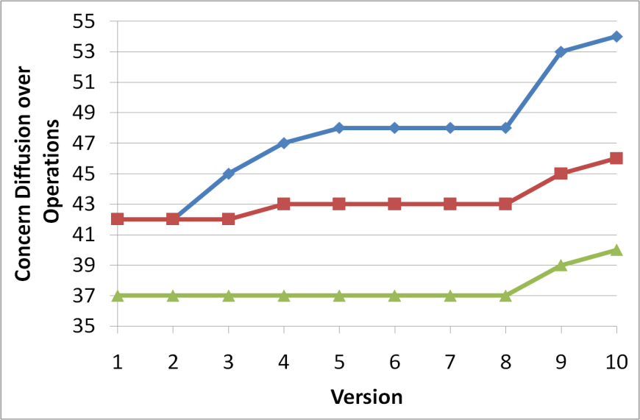
AO Improves Stability in Crosscutting Concerns
Concurrency
Improved encapsulation reduces scope.
Pointcuts absorb some changes.
Poor separation of concerns magnified in OO.
Concurrency

Slide 7
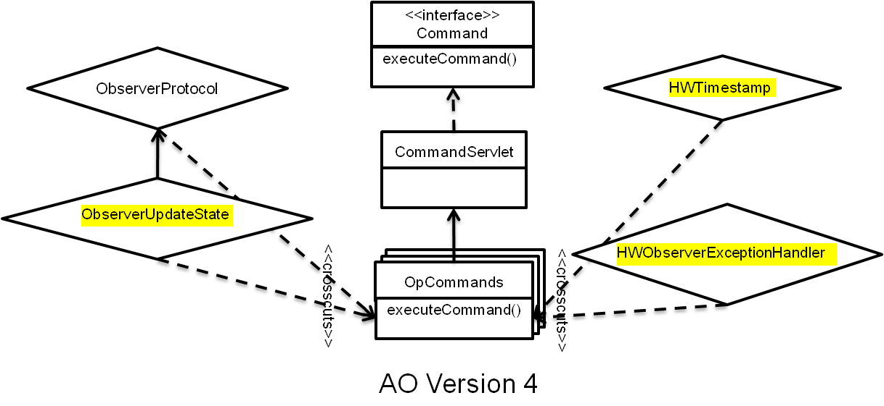
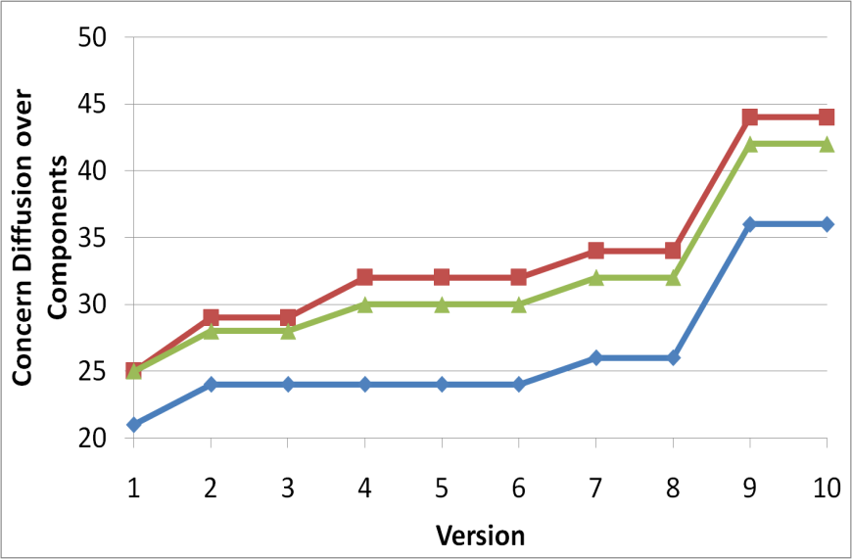
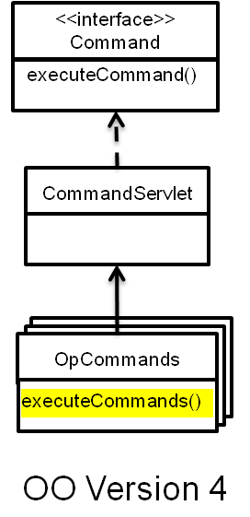
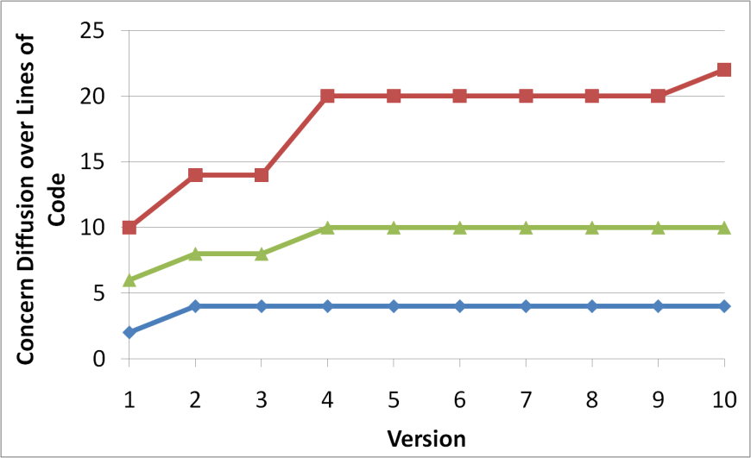
AO Has A Negative Impact on Non-Crosscutting Concerns
View
Slightly improved stability in OO.
OO decompositions sustain stability.
Introduction and modification of pointcuts cause instability.
View

Slide 8
Modularisation Outcomes
Concerns encapsulated upfront tend to have superior modularity stability.
  AO designs tend to have better stability when a change targets a crosscutting concern.
AO designs can affect non-crosscutting concerns.
Double-edged sword of pointcuts.
More results in the paper.

Slide 9
Change Impact
Useful to know the impact of a change to reflect on design tradeoffs.
  Quantitatively assess propagation effects.
Modularity metrics do not indicate the types of changes made.
  Number of components added/removed/modified.
  Number of operations added/removed/modified.
  Number of LOC, pointcuts, etc.
Can infer design principles.
  Open-closed principle.
  Ripple effects.

Slide 10
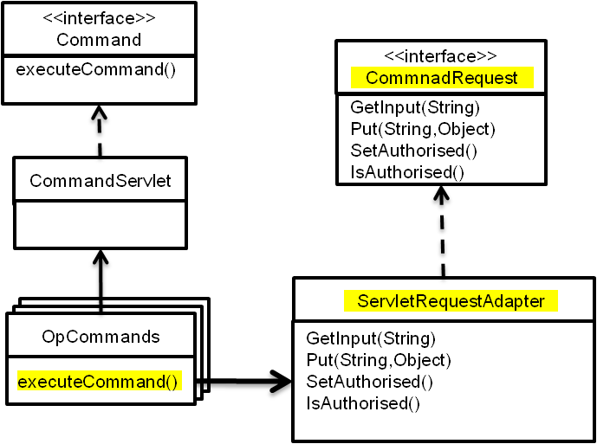
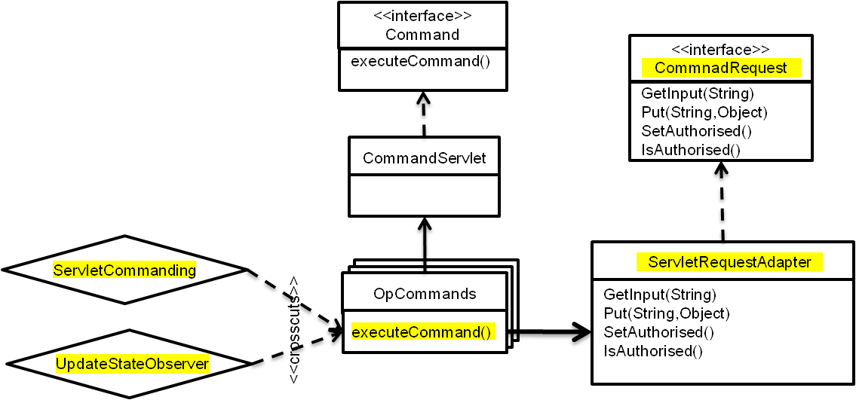
OO Requires Invasive Changes but Reduces Scope
OO changes tend to require more invasive changes.
  Increased tangling reduces the scope.
  Affect more operations and lines of code.
OO performs better or comparable to AO in some circumstances.
  Interesting as the AO versions have the same core layers.

Slide 11
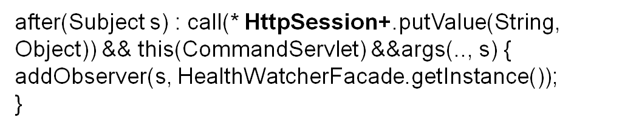
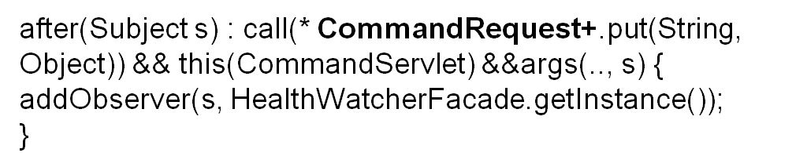
AO Preserves the Open-Closed Principle
AO changes tend to require more new components to be added.
  Absorbs invasive changes via inter-type declarations.
What is more desirable – modification or addition?
  Open-Closed principle.
Pointcut fragility is a significant factor of these ripple-effects
  Solution: more expressive and semantic-based pointcuts.

Slide 12
Deep vs. Wide Ripple Effects
OO ripple effects tend to go wider.
  They affect related classes more extensively.
AO ripple effects tend to go deeper.
  They affect more (seemingly) unrelated aspects.
Which is more desirable?
  Wider ripple effects more obvious.
  Modularity metrics would suggest otherwise...

Slide 13
Summary of Key Findings
Concerns aspectised upfront show superior stability.
AO solutions requires less intrusive changes.
AO solutions satisfy more closely the Open-Closed principle.
Both AO and OO solutions show good stability in high-level design structures.
AO modifications tend to propagate to unrelated components.
AO design degeneration occurred when aspectising exception handling.
Notes:
Artificial method signatures in order to expose contextual information for the exception handlers.

Slide 14
On the Impact of Aspectual Decompositions on Design Stability: An Empirical Study
Phil Greenwood
p.greenwood@lancaster.ac.uk
Study Resources: http://www.comp.lancs.ac.uk/~greenwop/ecoop07/
  Co-authors: Thiago Bartolomei, Eduardo Figueiredo, Marcos Dosea, Alessandro Garcia, Nelio Cacho, Claudio Sant’Anna, Sergio Soares, Paulo Borba, Uira Kulesza and Awais Rashid.

