Slide 1
Quality Assessment Methodologies for Linked Open Data
Ontologias e Web Semântica
Profs.: Fred Freitas e Bernadette Farias Lóscio
Aluno: Walter Travassos Sarinho
wts@cin.ufpe.br

Slide 2
Summary
Introduction
What is Data Quality?
The Data Quality Problem
Quality Dimensions
Relation between dimensions
Conclusions

Slide 3
Introduction
Overview on Quality Criteria under Linked Data Sources.
Web of Data comprises close to 50 billion facts represented as RDF triples [Zaveri et al. 2012]
Encouraging further experimentation and the development of new approaches focused towards data quality.

Slide 4
What is Data Quality?
Fitness to use [Wang et al. 1996] [Juran 1974] [Knight and Burn 2005]
The key challenge is to determine the data quality wrt. a particular use case.

Slide 5
The Data Quality Problem
Dataset published on Web of Data already cover a diverse set of domains, however, the datas on this environment reveals a largue variation in data quality.
For example, data extracted from semi-structured or even unstructed sources, such as Dbpedia, often contains inconsistencies as well as misrepresented and incomplete information. [Zaveri et al. 2012].

Slide 6
The Data Quality Problem
There are already many methodologies and frameworks available for assessing data quality, all addressing different aspects of this task by proposing appropriate methodologies, measures and tools. [...] However, data quality on the Web of Data also includes a number of novels aspects, such as coherence via links to external datasets, data representation quality or consistency with regard to implicit information [Zaveri et al. 2012].

Slide 7
The Data Quality Problem
Despite the quality in LOD being an essential concept, few efforts are currently in place to standardize how quality tracking and assurance should be implemented. Moreover, there is no consensus on how the data quality dimensions and metrics should be defined [Zaveri et al. 2012].

Slide 8
The Data Quality Problem
[Bizer et al 2009] Web-based information systems which integrate information from different providers.
[Mendes et al 2012] the problem is related to values being in conflict between different data sources as a consequence of the diversity of the data.
[Flemming 2010] does not a provide definition but implicicty explains the problem in terms os data diversity.
[Hogan et al 2012] the authors discuss about errors, noise or difficulties to access the information.

Slide 9
Data Quality Dimensions and Metrics
Dimensions are rather abstract concepts. The assessment metrics rely on quality indicators that allow for the assessment of the quality of a data source wrt. the criteria. [Flemming 2010]

Slide 10
Data Quality Assessment Method
A data quality assessment methodology is defined as the process of evaluating if a piece of data meets in the information consumers need in a specific use case [Bizer and Cyganiak 2009]. The process involves measuring the quality dimensions that are relevant to the user and comparing the assessment results with the users quality requirements.

Slide 11
Based on this...
There was a systematic review that generated 118 relevant articles between 2002 and 2012 that focus towards assessing the quality of Linked Open Data.
Analyzing these 118 retrieved articles, a total of 21 papers were found relevant for this survey.

Slide 12
the results were...
26 data quality dimensions (criteria) that can be applied to assess the quality of Linked Data sources.
The dimensions were grouped following a classification introduced in [Wang and Strong 1996] wich is further modified and extended as:

Slide 13
Contextual Dimensions
Trust Dimensions
Intrinsic Dimensions
Accessibility Dimensions
Representational Dimensions
Dataset Dynamicity

Slide 14
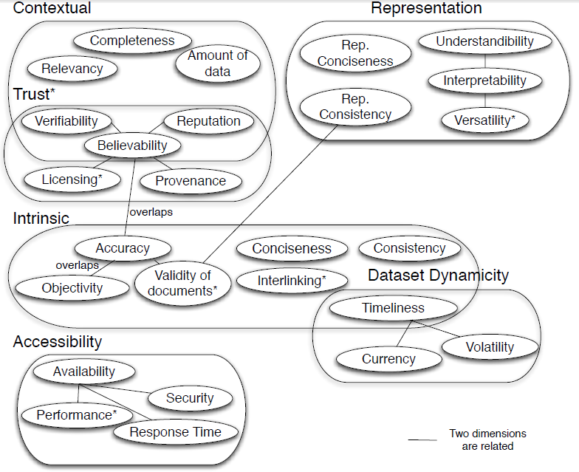

Slide 15
Contextual Dimensions
Are those that highly depend on the context of the task at hand as well as on the subjective preferences of the data consumer.
Completeness
Amount-of-data
Relevancy

Slide 16
Completeness
The degree to which information is not missing [Bizer 2007].
Schema Completeness
Data Completeness

Slide 17
Amount-of-data
Refers to the quantity and volume of data that is appropriate for a particular task.

Slide 18
Relevance
Refers to the provision of information which is in accordance with the task at hand and importance to the users’ query.
The extent to which information is applicable and helpful for the task at hand [Bizer 2007].

Slide 19
Relations between dimensions...
For instance, if a dataset is incomplete for a particular purpose, the amount of data is often insufficient. However, is the amount of data is too large, it could be that irrelevant data is provided, which affects the relevance dimension.

Slide 20
Trust Dimensions
Focus on the trustworthiness of the dataset.
Provenance
Verifiability
Reputation
Believability
Licensing

Slide 21
Provenance
Refers to the contextual metadata that focuses on how to represent, manage and use information about the origin of the source. Provenance helps to describe entities to enable trust, assess authenticity and allow reproducibility.

Slide 22
Verifiability
Refers to the degree by which a data consumer can assess the correctness of a dataset and, as a consequence, its trustworthiness.

Slide 23
Reputation
Is a judgement made by a user to determine the integrity of a source. It is mainly associated with a data publisher, a person, a organism, group of people or community of practice rather than being a characteristic of a dataset. The data publisher should be identifiable for a certain (part of a) dataset.
Is usually a score between 0 (low) and 1 (high).

Slide 24
Believability
Is defined as the degree to which the information is accepted to be correct, true, real and credible.
Can be subjectly mensured by analysing the provenance information of the dataset.
Can be seen as expected accuracy.

Slide 25
Licensing
Is defined as a granting of the permission for a consumer to re-use a dataset under defined conditions.

Slide 26
Relations between dimensions...
Verifiability is related to the believability dimension but, differs from it because even though verification can find whether information is correct or incorrect, belief is the degree to which a user thinks an information is correct.

Slide 27
Relations between dimensions...
The provenance information associated with a dataset assists a user in verifying the believability of a dataset. Therefore, believability is affiliated to the provenance of a dataset.
Licensing is also part of the provenance of a dataset and contributes towards ist believability.

Slide 28
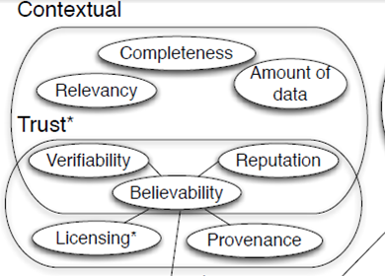
Relations between dimensions...
Highly dependent on the context of the task at hand.

Slide 29
Intrinsinc Dimensions
Are those that independent of the user's context. These dimensions focus on whether information correctly represents the real world and wheter information is logically consistent in itself.
Accuracy
Objectivity
Validity-of-documents
Interlinking
Consistency
Conciseness

Slide 30
Accuracy
Can be defined as the extent to which data is correct, that is, the degree to which it correctly represents the real world facts and is also free of error.
In particular, we associate accuracy mainly to semantic accuracy which relates to the correctness of a value to the actual real world value, that is, accuracy of the meaning.

Slide 31
Objectivity
Is defined as the degree to which the interpretation and usage of data is unbiased, unprejudiced and impartial. This dimensions highly depends on the type of information and therefore is classified as a subjective dimension.

Slide 32
Validity-of-documents
Refers to the valid usage of the underlying vocabularies and the valid syntax of the documents (syntactic accuracy).

Slide 33
Interlinking
Refers to the degree to which entities that represent the same concept are linked to each other.

Slide 34
Concistency
Means that a knowledge base is free of (logical / formal) contradictions wrt. a particular knowledge representation and inference mechanisms.
A more generic definition is that "a dataset is consistent if it is free of conflicting information" [Mendes 2012].

Slide 35
Conciseness
Refers to the redundance of entities, be it at the schema or the data level. Thus, conciseness can be classified into (i) intensional conciseness (schema level) which refers to the redundant attributes (e. g. two equivalent attributes with different names) and (ii) extensional conciseness (data level) which refers to redundant objects(e. g. two equivalent objects with different identifiers).

Slide 36
Relations between dimensions...
Objectivity overlaps with the concept of accuracy but differs from it because the concept of accuracy does not heavily depend on the consumers’ preference.

Slide 37
Relations between dimensions...
Objectivity is also related to the verifiability dimension, that is, the more verifiable a source is, the more objective it will be.
Accuracy, in particular the syntactic accuracy of the documents, is related to the validity-of-documents dimension.

Slide 38
Accessibility Dimensions
Dimensions belonging to this category involve aspects related to the way data can be accessed and retrieved.
Availability
Performance
Security
Response-time

Slide 39
Availability
Availability of a dataset is the extent to which information is present, obtainable and ready for use.

Slide 40
Performance
Refers to the efficient of a system that binds to a large dataset, that is, the more performant a data source the more efficiently a system can process data.

Slide 41
Security
Refers to "the possibility to restrict access to the data and to guarantee the confidentiality of the communication between a source and its consumers" [Flemming 2010].

Slide 42
Response-time
Measures the delay, usually in seconds, between submission of a query by the user and reception of the complete response from the dataset.

Slide 43
Relations between dimensions...
Performance of a system is related to the availability and response-time dimensions. Only if a dataset is available or has low response time, it can perform well. Security is also related to the availability of a dataset because the methods used for restricting users is tied to the way a user can access a dataset.

Slide 44
Representational Dimensions
Capture aspects related to the desing of the data.
Representational-consiness
Representational-consistency
Understandibility
Interpretability
Versatility

Slide 45
Representational-consiness
Refers to the representation of the data which is compact and well formatted on the one hand but also clear and complete on the other hand.
"The extent to which information is compactly represented" [Bizer 2007].

Slide 46
Representational-consistency
The extent to which information is represented in the same format [Bizer 2007].
Can be assessed by detecting whether the dataset re-uses existing vocabularies or terms from existing established vocabularies to represent its entities.

Slide 47
Understandability
Refers to the ease with which data can be comprehended, without ambiguity, and used by a human consumer. Thus, this dimension can also be referred to as the comprehensibility of the information where the data should be of sufficient clarity in order to be used.

Slide 48
Interpretability
Refers to technical aspects of data, that is whether information is represented using an appropriate notation and whether it conforms to the technical ability of the consumer.
Is defined as the "extent to which information is in appropriate languages, symbols, and units, and the definitions are clear" [Bizer 2007].

Slide 49
Versatility
Mainly refers to the alternative representations of data and its subsequent handling. Additionally, versatility also corresponds to the provision of alternative access methods for a dataset.
Is defined as "the alternative representations of the data and its handling" [Flemming 2010].

Slide 50
Relations between dimensions...
Understandability is related to the interpretability dimension as it refers to the subjective capability of the information consumer to comprehend information.
Interpretability mainly refers to the technical aspects of the data, that is if it is correctly represented.
Versatility is also related to the interpretability of a dataset as the more versatile forms a dataset is represented in (for e. g. in different languages), the more interpretable a dataset is.

Slide 51
Relations between dimensions...
Representational-consistency is related to the validity-of-documents, an intrinsic dimension, because the invalid usage of vocabularies may lead to inconsistency in the documents.

Slide 52
Dataset Dynamicity
An important aspect of data is its update over time. The main dimensions related to the dynamicity of a dataset are:
Currency
Volatility
Timeliness

Slide 53
Currency
Refers to the speed with which the information (state) is updated after the real-world information changes.

Slide 54
Volatility
Can be defined as the lenght of time during which the data remains valid.

Slide 55
Timeliness
Refers to the time point at which the data is actually used. This can be interpreted as whether the information is available in time to be useful.

Slide 56
Relations between dimensions...
Timeliness depends on both the currency and volatility dimensions. Currency is related to volatility since currency of data depends on how volatile it is. Thus, data that is highly volatile must be current, while currency is less important for data with low volatility.

Slide 57
Conclusion
There are many ways to assess the quality of a dataset.
This work is a initial study about the state of art of quality criteria for linked data sources.
Evaluate quality of a data source should always take into consideration the quality requirements of the user.

Slide 58
References
[Bizer 2007] BIZER, C. Quality-Driven Information Filtering in the Context of Web-Based Information Systems. PhD thesis, Freie Universität Berlin, March 2007.
[Bizer and Cyganiak 2009] BIZER, C., AND CYGANIAK, R. Quality-driven information filtering using the wiqa policy framework. Web Semantics 7, 1 (Jan 2009), 1 – 10.
[Flemming 2010] FLEMMING, A. Quality characteristics of linked data publishing datasources. Master’s thesis, Humboldt-Universität zu Berlin, 2010.
[Hogan 2010] HOGAN, A., HARTH, A., PASSANT, A., DECKER, S., AND POLLERES, A. Weaving the pedantic web. In LDOW (2010).
[Juran 1974] JURAN, J. The Quality Control Handbook. McGraw-Hill, New York, 1974.
[Knight and Burn 2005] KNIGHT, S., AND BURN, J. Developing a framework for assessing information quality on the world wide web. Information Science 8 (2005), 159 – 172.
[Mendes 2012] MENDES, P., MÜHLEISEN, H., AND BIZER, C. Sieve: Linked data quality assessment and fusion. In LWDM (March 2012).
[Wang and Strong 1996] WANG, R. Y., AND STRONG, D. M. Beyond accuracy: what data quality means to data consumers. Journal of Management Information Systems 12, 4 (1996), 5–33.
[Wang 1996] WAND, Y., AND WANG, R. Y. Anchoring data quality dimensions in ontological foundations. Communications of the ACM 39, 11 (1996), 86–95.
[Zaveri et al 2012] ZAVERI, A., RULA, A., MAURINO, A., PIETROBON, R., et al. Quality Assessment Methodologies for Linked Open Data. Semantic-Web journal 2012

Slide 59
Obrigado!!

