Slide 1
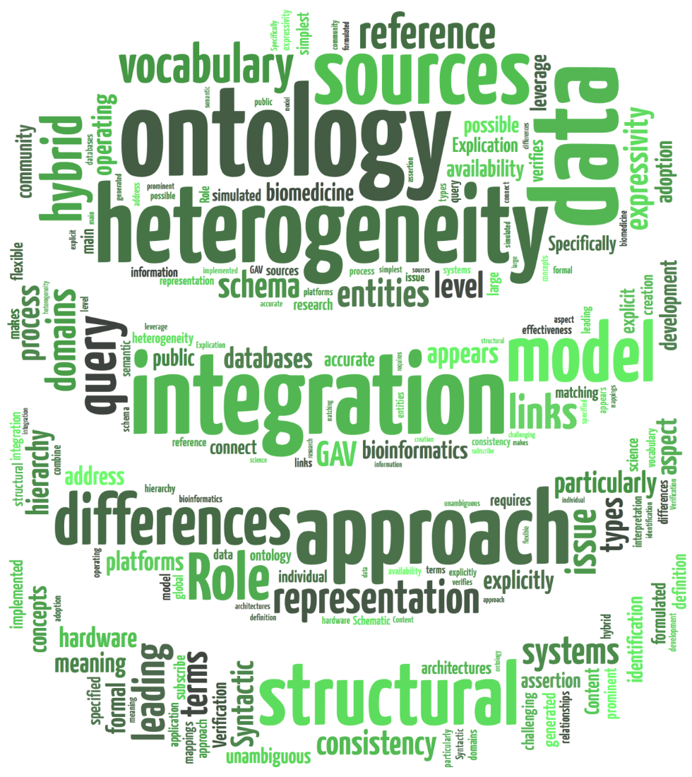
ONTOLOGY INTEGRATION HETEROGENEITY, TECHNIQUES AND MORE
Adriel Café aac3@cin.ufpe.br

Slide 2
ONTOLOGY INTEGRATION
Adriel Café <aac3@cin.ufpe.br>
The concept of “integration” means anything ranging from integration, merges, use, mapping, extending, approximation, unified views and more. [Keet]

Slide 3
ONTOLOGY INTEGRATION
Adriel Café <aac3@cin.ufpe.br>
Mapping
“Given two ontologies, how do we find similarities between them, determine which concepts and properties represent similar notions, and so on.” [Noy]
Matching & Alignment
“Ontology matching is the process of finding the relations between ontologies, and we call alignment the result of this process expressing declaratively these relations.” [Euzenat, Mocan]
Merging
“The process of ontology merging takes as input two (or more) source ontologies and returns a merged ontology based on the given source ontologies.” [Stumme, Maedche]

Slide 4
ONTOLOGY INTEGRATION
Adriel Café <aac3@cin.ufpe.br>
Mapping
Merging
Ontology A
Ontology B
Mapping
Ontology A
Ontology B
Ontology C

Slide 5
ONTOLOGY INTEGRATION
Adriel Café <aac3@cin.ufpe.br>
[Keet]

Slide 6
NON-DISRUPTIVE INTEGRATION AND (RE)USE OF ONTOLOGIES
Adriel Café <aac3@cin.ufpe.br>
[Calvanese et al.] consider mapping between one global and several local ontologies leaving the local ontologies intact by querying the local ontologies and converting the query result into a concept in the global ontology.

Slide 7
FEATURES OF ONTOLOGY
Adriel Café <aac3@cin.ufpe.br>
Establishes a formal vocabulary to share information between applications
Inference is one of the main characteristics of ontologies
Top-level Ontology
Describes very general concepts that are present in several areas, e.g., SUMO (Suggested Upper Merged Ontology), DOLCE (Descriptive Ontology for Linguistic and Cognitive Engineering), BFO (Basic Formal Ontology)
Domain Ontology
Ontologies specialize in a subset of generic ontologies in a domain or subdomain, e.g., Gene Ontology, Protein Ontology, Health Indicator Ontology, Environment Ontology

Slide 8
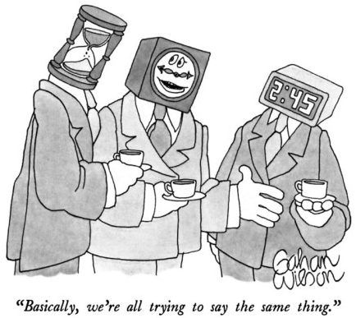
THE PROBLEM OF HETEROGENEITY
Adriel Café <aac3@cin.ufpe.br>
Even with all these advantages, still need to map the sources
Top-level Ontologies and Domain Ontologies can drastically decrease the complexity

Slide 9
DIFFERENCES BETWEEN ONTOLOGIES [Goh, 1996]
Adriel Café <aac3@cin.ufpe.br>
1 Schematic
Data type, the most obvious one being numbersas integers or as strings.
Labelling, only the strings of the name of the concept differ but not the definition, analogous to Wiederhold’s (1994) naming. This also includes labelling of attributes and their values.
Aggregation, e.g. organizing organisms by test site or by speciesin biodiversity
Generalization, an entity type Micro Organismsin one model and in another, there are Bacteria, Fungiand Archae.

Slide 10
DIFFERENCES BETWEEN ONTOLOGIES [Goh, 1996]
Adriel Café <aac3@cin.ufpe.br>
2 Semantic
Naming, includes problems with synonyms (e.g. maize and corn) and homonyms (worm as animal, as muscle under the tongue and as infection in the computer) of concepts and their properties (attributes).
Scaling and units, on scaling: one system with possible values white, pink, redand the other uses the full range of RGB; units: metric and imperial system.
Confounding, a concept that is the same, but in reality different; primarily has an effect on the attribute values, like latestMeasuredTemperature, that does not refer to one and the same over time.

Slide 11
DIFFERENCES BETWEEN ONTOLOGIES [Goh, 1996]
Adriel Café <aac3@cin.ufpe.br>
3 Intensional
Domain, integrate ontologies of different domains.
Integrity constraint, the identifier in one model may not suffice for another, for example one animal taxonomicmodel uses an [automatically generated and assigned] ID number to identify each instance, whereas another system assumes each animal has a distinct name.

Slide 12
DIFFERENCES BETWEEN ONTOLOGIES [Klein, 2001]
Adriel Café <aac3@cin.ufpe.br>
Language Level
Languages can differ in their syntax
Constructs available in one language are not available in another, e.g., disjoint, negation
OWL Full, OWL DL, OWL Lite, OWL 2 EL, OWL 2 QL, OWL 2 RL
Ontology Level
Using the same linguistic terms to describe different concepts, e.g.,
Use different terms to describe the same concept, e.g.,
Using different modeling paradigms
Use different levels of granularity

Slide 13
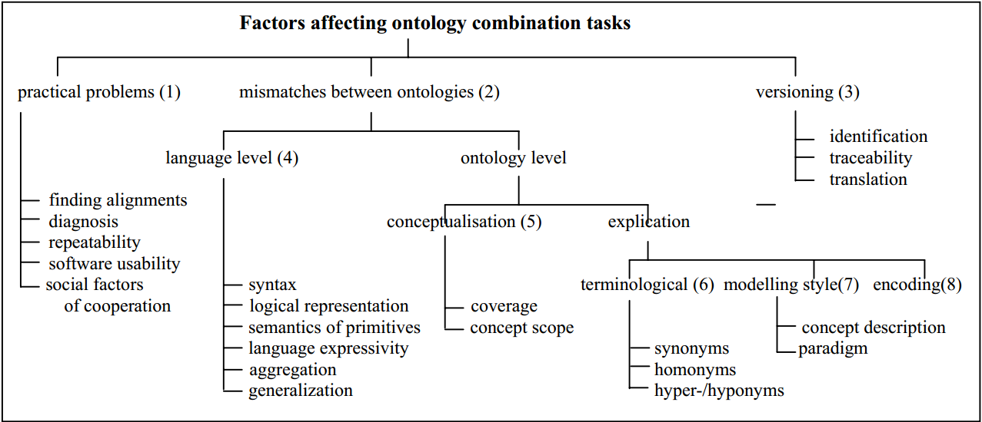
DIFFERENCES BETWEEN ONTOLOGIES [Klein, 2001]
Adriel Café <aac3@cin.ufpe.br>

Slide 14
DIFFERENCES BETWEEN ONTOLOGIES
Adriel Café <aac3@cin.ufpe.br>
Example Two ontologies that describe people, projects, publications…
Portal Ontology http://www.aktors.org/ontology/portal
Person Ontology http://ebiquity.umbc.edu/ontology/person.owl

Slide 15
DIFFERENCES BETWEEN ONTOLOGIES
Adriel Café <aac3@cin.ufpe.br>
 | Portal Ontology | Person Ontology
Different names for the same concept | PhD-Student | PhDStudent
Same term for different concepts | Project Only the current project | Project Past projects and proposals
Scope | Includes journals and publications composed | Includes students and guest speakers
Different modeling conventions | Journal is a class | journal is a property
Granularity | Professor-In-Academia | adjunct, affiliated, associate, principal

Slide 16
DISCOVERING MAPPINGS
Adriel Café <aac3@cin.ufpe.br>
Using Top-level Ontologies
They are designed to support the integration of information
Examples: SUMO, DOLCE
Using the ontology structure
Metrics to compare concepts
Explore the semantic relations in the ontology, e.g., SubClassOf, PartOf, class properties, range of properties
Examples : Similarity Flooding, IF-Map, QOM, Chimaera, Prompt

Slide 17
DISCOVERING MAPPINGS
Adriel Café <aac3@cin.ufpe.br>
Using lexical information
String normalization
String distance
Soundex Phonetic algorithm, e.g., Kennedy, Kennidi, Kenidy, Kenney...
Thesaurus Dictionary with words grouped by similarity
Through user intervention
Providing information at the beginning of the mapping
Providing feedback on the maps generated

Slide 18
DISCOVERING MAPPINGS
Adriel Café <aac3@cin.ufpe.br>
Methods based on rules
Structural and lexical analysis
Methods based on graphs
These ontologies as graphs and compares the corresponding subgraphs
Machine learning approaches
Probabilistic approaches
Reasoning and theorem proving

Slide 19
REPRESENTING MAPPINGS
Adriel Café <aac3@cin.ufpe.br>
ont1:Teacher
owl:sameAs
ont2:Instructor
ont1:Student
owl:disjointWith
ont2:Instructor
ont1:School
rdf:subClassOf
ont2:Institution

Slide 20
REPRESENTING MAPPINGS
Adriel Café <aac3@cin.ufpe.br>
<Alignment> <xml>yes</xml> <level>0</level> <type>**</type> <onto1>http://www.example.org/ontology1</onto1> <onto2>http://www.example.org/ontology2</onto2> <map> <Cell> <entity1 rdf:resource=’http://www.example.org/ontology1#reviewedarticle’/> <entity2 rdf:resource=’http://www.example.org/ontology2#article’/> <measure rdf:datatype=’http://www.w3.org/2001/XMLSchema#float’>0.6363636363636364</measure> <relation>=</relation> </Cell> <Cell> <entity1 rdf:resource=’http://www.example.org/ontology1#journalarticle’/> <entity2 rdf:resource=’http://www.example.org/ontology2#journalarticle’/> <measure rdf:datatype=’http://www.w3.org/2001/XMLSchema#float’>1.0</measure> <relation>=</relation> </Cell> </map> </Alignment>
Alignment API [Euzenat et al.]

Slide 21
WE HAVE THE MAPPING. NOW WHAT?
Adriel Café <aac3@cin.ufpe.br>
Ontology Merging
Examples: OntoMerge
Query answering
Peer-to-Peer (P2P) Architecture
Ontology Integration System (OIS)
Reasoning with mappings
Examples: Pellet, HermiT, FaCT++

Slide 22
CONCLUSION
Adriel Café <aac3@cin.ufpe.br>
Ontologies have a great power of expression
Semantic integration is a major challenge of the Semantic Web
Questions to be answered
Imperfect and inconsistent mappings are useful?
How to maintain mappings when ontologies evolve?
How do we evaluate and compare different tools?

Slide 23
REFERENCES
Adriel Café <aac3@cin.ufpe.br>
D. Calvanese, “A framework for ontology integration” Emerg. Semant. …, 2002.
D. Calvanese, G. De Giacomo, and M. Lenzerini, “Ontology of Integration and Integration of Ontologies” Descr. Logics, 2001.
A. Doan and J. Madhavan, “Learning to map between ontologies on the semantic web” … World Wide Web, pp. 662–673, 2002.
M. Ehrig, S. Staab, and Y. Sure, “Framework for Ontology Alignment and Mapping” pp. 1–34, 2005.
J. Euzenat and P. Valtchev, “Similarity-based ontology alignment in OWL-Lite1” … Artif. Intell. August 22-27, …, 2004.
N. Noy, “Ontology Mapping and Alignment” Fifth Int. Work. Ontol. Matching …, 2012.
N. Noy, “Semantic integration: a survey of ontology-based approaches” ACM Sigmod Rec., vol. 33, no. 4, pp. 65–70, 2004.
P. Shvaiko and J. Euzenat, “Ontology matching: state of the art and future challenges” vol. X, no. X, pp. 1–20, 2012.
M. Uschold, “Ontologies and Semantics for Seamless Connectivity” vol. 33, no. 4, pp. 58–64, 2004.
M. Keet, “Aspects of Ontology Integration”, 2004.

