Slide 1
Ontology-based Information Extraction
Hilário Tomaz Alves de Oliveira

Slide 2
Introduction
Introduction
Motivation
Definition
Problem
Information Extraction Methods
Evaluation
Futures Directions
References

Slide 3
Introduction
Introduction
Motivation
Definition
Problem
Information Extraction Methods
Evaluation
Futures Directions
References

Slide 4
Motivation
Automatically processing the information contained in natural language text
80% of the data present in the Web are in natural language [Chen, 2001]
Manually processing is becoming increasingly difficult
Necessity of to process these information automatically

Slide 5
Motivation
Creating semantic contents for the Semantic Web
Converting the information contained in existing web pages into ontologies
Improving the quality of ontologies
OBIE good => ontology good

Slide 6
Definition >> Key Characteristics
Process unstructured/semi-structured natural language text
NLP Techniques/Wrappers
Present the output using ontologies
Use an IE process guided by an ontology
process is “guided” by the ontology to extract instances of classes, data properties and relations

Slide 7
Definition >> Key Characteristics
Ontology Population ⊂ OBIE
OBIE follows the paradigm of Open Information Extraction [Etzioni, 2007]
Extractors can be inside/outside ontology
guided by
Information
Extractor
Ontology

Slide 8
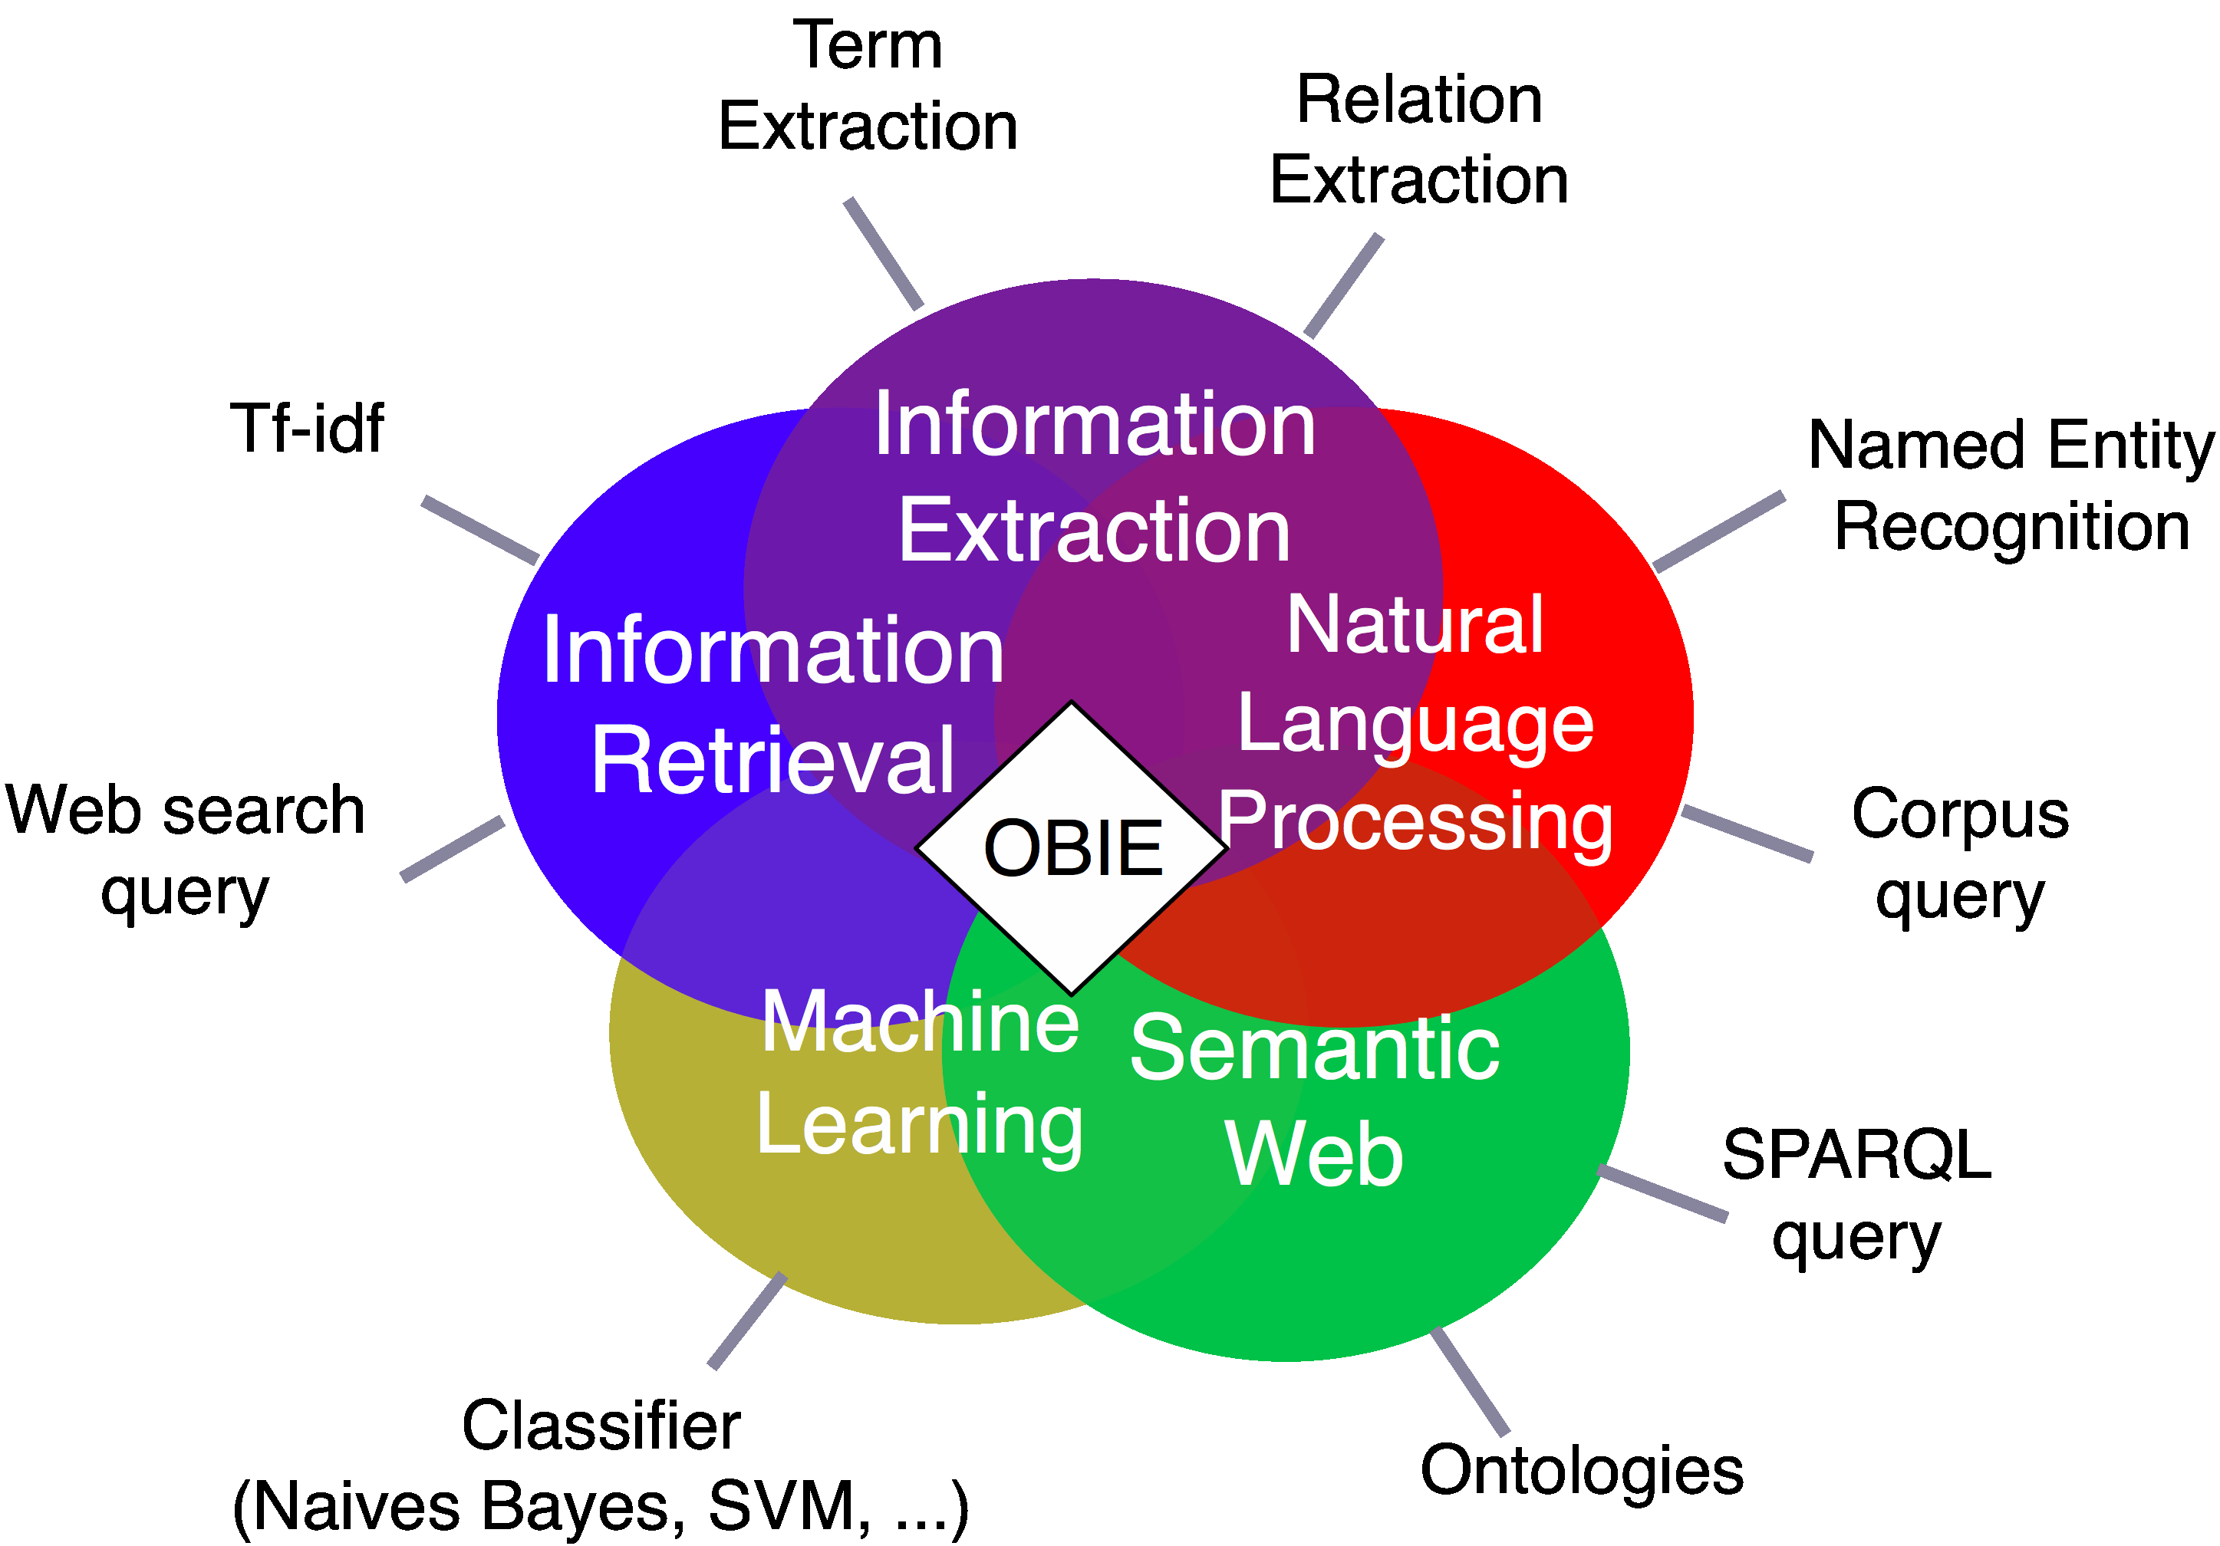
Definition
Ontology-based Information Extraction System (OBIE):
“A system that processes unstructured or semi-structured natural language text guided by an ontology and presents the output in an ontology” [WIMALASURIYA and DOU 2010]

Slide 9
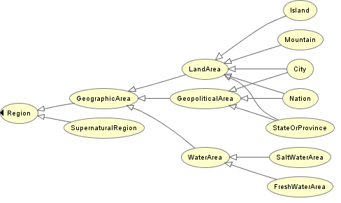
Definition >> Problem
Conceptualization of a domain
have symptoms
Disease
Symptom
OBIE system
Instances
have symptoms
Dengue
Fever

Slide 10
Introduction
Introduction
Motivation
Definition
Problem
Information Extraction Methods
Evaluation
Futures Directions
References

Slide 11
Introduction
Introduction
Motivation
Definition
Problem
Information Extraction Methods
Evaluation
Futures Directions
References

Slide 12
Information Extraction Method
Main IE methods employed by the OBIE systems
Linguistic rules represented by regular expressions
Gazetteer Lists
Classification techniques
Partial Parse Trees
Analyzing HTML/XML tags
Web-based search

Slide 13
Linguistic rules represented by regular expressions
Specifying regular expressions that capture certain types of information
E.G. (watched|seen) <NP>,
where <NP> denotes a noun phrase
Are combined with NLP tools
Part-of-Speech (POS) taggers
Noun Phrase Chunkers

Slide 14
Linguistic rules represented by regular expressions
The rules can be constructed:
Manually
Automatically
This Technique has a
High precision
Low Recall

Slide 15
Linguistic rules represented by regular expressions
This technique is used by a several OBIE systems, such as
FASTUS IE [APPELT et al., 2003]
OntoX [Yildiz and Miksch, 2007]
Textpresso [Müller et al., 2004]
KIM [Popov et al., 2003]

Slide 16
Gazetteer Lists
Recognizes individual words or phrases instead of patterns
Provided in the form of a list, known as a Gazetteer List
Widely used in the Named-entity Recognition task
Requirements
Specify what is being extracted
Specify sources and avoid manual creation

Slide 17
Gazetteer Lists
These first Post Doctoral Research Fellowships are available to incoming candidates from one of the following countries who have recently obtained their PhD in the humanities, social sciences, or natural sciences & engineering. Citizenship from eligible countries required: Brazil, France, Germany, Italy, Japan, Mexico, New Zealand, Norway, Republic of Korea, Russia, Switzerland, UK
Countries
Brazil
France
Italy
Japan
.
.

Slide 18
Gazetteer Lists
Some OBIE systems that used this technique
SOBA system [Buitelaar and Siegel, 2006]
OBIE system for business intelligence [ Saggion et al., 2007]

Slide 19
Classification techniques
Uses supervised classification algorithms to identify different components of an ontology
Instances of classes and properties values
Different linguistic features are used as input for classification
POS tags
Capitalization Information
Individual words

Slide 20
Classification techniques
Several supervised classification algorithms haven been used
Support Vector Machines (SVM)
Maximum Entropy models
Decision Trees
Hidden Markov Models (HMM)
Conditional Random Fields (CRF)

Slide 21
Classification techniques
OBIE systems that implemented this method are
Using uneven margins SVM and perceptron for information extraction [Li et al., 2005]
Hierarchical, perceptron-like learning for ontology-based information extraction [Li and Bontcheva, 2007]

Slide 22
Partial Parse Trees
A small number of OBIE systems construct a semantically annotated parse tree for the text as a part of the IE process
TACITUS [Hobbs, 1988]
Bootstrapping an ontology-based information extraction system [Maedche et al., 2003]
Text-To-Onto [Maedche and Staab, 2000]
Vulcain [Todirascu et al., 2002]

Slide 23
Partial Parse Trees
Produces an under-specified dependency structure as the output
Partial parse tree
Not meant to comprehensively represent the semantic content of the text
Not Deep NLP

Slide 24
Partial Parse Trees

Slide 25
Analyzing HTML/XML tags
Use HTML or XML pages as input to extract certain types of information using the tags of these documents
E. G. a system that is aware of the html tags for tables can extract information from tables present in html pages

Slide 26
Analyzing HTML/XML tags
SOBA system [Buitelaar and Siegel, 2006] is an example of system that use this method
It extracts information from HTML tables into a knowledge base that uses F-Logic

Slide 27
Web-based search
The general idea behind this approach is using the web as a big corpus
Using queries on web-based search engines
Example of OBIE systems that used this method:
Towards the self-annotating web [Cimiano et al., 2004]
PANKOW [Cimiano et al., 2005]

Slide 28
Web-based search

Slide 29
Introduction
Introduction
Motivation
Definition
Problem
Information Extraction Methods
Evaluation
Futures Directions
References

Slide 30
Introduction
Introduction
Motivation
Definition
Problem
Information Extraction Methods
Evaluation
Futures Directions
References

Slide 31
Evaluation
Traditional metrics for performance evaluation in IE
Precision: |correct answers | / |all answers retrieved|
Recall: |correct answers | / |all answers available|
F – Measure: weighted average of precision and recall
Precision and Recall with OBIE can be problematic
Binary in nature (correct or incorrect)

Slide 32
Evaluation
Evaluation of OBIE systems must allow different degrees of correctness
Scalar manner
For the task of identifying instances of an ontology some metrics can be used

Slide 33
Evaluation
Learning Accuracy (LA) [Maynard, 2006]
Traditional Precision and Recall + some kind of semantic distance weights
SP (Shortest Path) - shortest length from root to the key concept
FP - shortest length from root to the predicted concept. If the predicted concept is correct, then FP = 0

Slide 34
Evaluation
CP (Common Path) - shortest length from root to the MSCA (Most Speciﬁc Common Abstraction)
DP - shortest length from MSCA to predicted concept

Slide 35
Evaluation
Augmented Precision (AP) and Augmented Recall (AR) [Maynard, 2006]
Traditional Precision and Recall + cost-based component

Slide 36
Evaluation
Uses the following measurements
MSCA: most speciﬁc concept common to the key and
response paths
CP: shortest path from root concept to MSCA
DPR: shortest path from MSCA to response concept
DPK: shortest path from MSCA to key concept

Slide 37
Evaluation
The following concrete implementations are the result
n0: the average chain length of the whole ontology, computed from the root concept
n2: the average length of all the chains containing the key concept, computed from the root concept
n3: the average length of all the chains containing the response concept, computed from the root concept
BR: the branching factor of each relevant concept, divided by the average branching factor of all the nodes from the ontology, excluding leaf nodes

Slide 38
Evaluation

Slide 39
Introduction
Introduction
Motivation
Definition
Problem
Information Extraction Methods
Evaluation
Futures Directions
References

Slide 40
Introduction
Introduction
Motivation
Definition
Problem
Information Extraction Methods
Evaluation
Futures Directions
References

Slide 41
Future directions [WIMALASURIYA and Dou, 2010]
Improving the effectiveness of the IE process
Improving Precision and Recall
Integrating OBIE systems with the Semantic Web
Where to place the OBIE systems and Semantic Web interfaces ????
Improving the use of ontologies
Good OBIE system extraction ⬄ Good ontology

Slide 42
Introduction
Introduction
Motivation
Definition
Problem
Information Extraction Methods
Evaluation
Futures Directions
References

Slide 43
Introduction
Introduction
Motivation
Definition
Problem
Information Extraction Methods
Evaluation
Futures Directions
References

Slide 44
References
APPELT, D. E; Hobbs, J.R; Bear, J.; Israel, D. J. Tyson, M.; FASTUS: A Finite-state Processor for Information Extraction from Real-world Text. In: Ruzena Bajcsy (ed.), Proceedings of the 13th International Joint Conference on Artificial Intelligence (Morgan Kaufmann, Chambéry, France, 1993)
BUITELAAR, P., Siegel, M. Ontology-based information extraction with SOBA. In: Proceedings of the Fifth International Conference on Language Resources and Evaluation (European Language Resources Association, Genoa, Italy, 2006)
CARLSON, A.; Betteridge, J.; Kisiel, B.; Settles, B.; Hruschka Jr., Mitchell, T. M. Toward an Architecture for Never-Ending Language Learning. In Proceedings of the Conference on Artificial Intelligence (AAAI), 2010.
CHEN, H., Knowledge management systems: a text mining perspective. University of Arizona (Knowledge Computing Corporation), Tucson, Arizona, 2001

Slide 45
References
CIMIANO, P.; Ladwig, G.; Staab, S. Gimme’ the context: context-driven automatic semantic annotation with C-PANKOW. In: Proceedings of the 14th International Conference on World Wide Web (ACM, New York, 2005)
CIMIANO, P.; Handschuh, S.; Staab, S. Towards the self-annotating web. In: Proceedings of the 13th International Conference on World Wide Web (ACM, New York, 2004)
ETZIONI, O.; Banko, M.; Cafarella, M. J.; Soderland, S.; Broadhead M. Open information extraction from the web. In: Proceedings of the 20th International Joint Conference on Artificial Intelligence (AAAI Press, Menlo Park, CA, 2007)
LI, Y.; Bontcheva, H. Hierarchical, perceptron-like learning for ontology-based information extraction. In: Proceedings of the 16th International Conference on World Wide Web (ACM, New York, 2007).

Slide 46
References
LI, Y.; Bontcheva, K.; Cunningham, H. Using uneven margins SVM and perceptron for information extraction. In: Proceedings of the 9th Conference on Computational Natural Language Learning (Association for Computational Linguistics, Morristown, NJ, 2005).
HOBBS, J.R.; Stickel, M.; Martin, P.; Edwards, D. Interpretation as abduction. In: Proceedings of the 26th Annual Meeting on Association for Computational Linguistics (Association for Computational Linguistics, Morristown, NJ, 1998)
MAEDCHE, A., Neumann, G., Staab, S. Bootstrapping an ontology-based information extraction system. In: P.S. Szczepaniak, J. Segovia, J. Kacprzyk and L.A. Zadeh (eds), Intelligent Exploration of the Web, (Physica-Verlag GmbH, Heidelberg, Germany, 2003)
MAEDCHE A. Staab, S. The Text-To-Onto Ontology Learning Environment. In: Software Demonstration at the Eighth International Conference on Conceptual Structures (Springer-Verlag, Berlin, 2000)

Slide 47
References
MAYNARD, D. Peters, W.; Li, Y. Metrics for evaluation of ontology-based information extraction. In: Proceedings of the WWW 2006 Workshop on Evaluation of Ontologies for the Web (ACM, New York, 2006)
MÜLLER, H. M.; Kenny, E. E.; Sternberg, P. W. Textpresso: an ontology-based information retrieval and extraction system for biological literature, PLoS Biology 2(11) (2004) 1984–1998
POPOV, B.; Kiryakov, A.; Kirilov, A.; Manov, D.; Ognyanoff D.; Goranov, M. KIM – semantic annotation platform. In: Proceedings of the 2nd International Semantic Web Conference (Springer-Verlag, Berlin, 2003).
SAGGION, H., Funk, A., Maynard, D., Bontcheva, K. Ontology-based information extraction for business intelligence. In ISWC/ASWC, pages 843–856, 2007.

Slide 48
References
TODIRASCU, A.; Romary L.; Bekhouche, D. Vulcain – an ontology-based information extraction system. In: Proceedings of the 6th International Conference on Applications of Natural Language to Information Systems-Revised Papers (Springer-Verlag, London, 2002).
YILDIZ, B., Miksch, S. OntoX – a method for ontology-driven information extraction. In: Proceedings of the 2007 International Conference on Computational Science and its Applications (Springer, Berlin, 2007).
WIMALASURIYA, D. C.; Dou, D. Ontology-Based Information Extraction: An Introduction and a Survey of Current Approaches. Journal of Information Science (JIS). Volume 36, Number 3, pp. 306-323, 2010.

Slide 49
Never Ending Learning [Carlson, 2010]
An intelligent computer agent that runs forever and that each day must:
(1) extract, or read, information from the web to populate a growing structured knowledge base
(2) learn to perform this task better than on the previous day

Slide 50
Never Ending Learning [Carlson, 2010]
Acquires two types of knowledge:
(1) knowledge about which noun phrases refer to which speciﬁed semantic categories, such as cities, companies, sports …
(2) knowledge about which pairs of noun phrases satisfy which speciﬁed semantic relations, such as hasOf-ﬁcesIn(organization, location)

Slide 51
Never Ending Learning [Carlson, 2010]
Input:
An ontology specifying a set of categories
A knowledge base containing instances of these categories (perhaps including errors)
A large text corpus

Slide 52
Never Ending Learning [Carlson, 2010]
Output:
A set of two-argument relations that are frequently mentioned in the text corpus
RiverFlowsThroughCity(<River>,<City>)
For each proposed relation, a set of instances
RiverFlowsThroughCity(“Nile”,”Cairo”)

Slide 53
Never Ending Learning [Carlson, 2010]

Slide 54
Ontology-based Information Extraction
DÚVIDAS ???
Hilário Tomaz Alves de Oliveira

