Slide 1

Type checking
http://pan.cin.ufpe.br
Notes:
Sist. Tipos java: giov + arrays
As => numbers

Slide 2
Definition of type system
“A type system is a tractable syntactic method for proving the absence of certain program behaviors by classifying phrases according to the kinds of values they compute.”
Types and Programming Languages. B.C.Pierce.

Slide 3
Definition of type system
“A type system is a tractable syntactic method for proving the absence of certain program behaviors by classifying phrases according to the kinds of values they compute.”
Types and Programming Languages. B.C.Pierce.
A type checker is an efficient algorithm

Slide 4
Definition of type system
“A type system is a tractable syntactic method for proving the absence of certain program behaviors by classifying phrases according to the kinds of values they compute.”
Types and Programming Languages. B.C.Pierce.
Sound but incomplete: can reject valid programs

Slide 5
Definition of type system
“A type system is a tractable syntactic method for proving the absence of certain program behaviors by classifying phrases according to the kinds of values they compute.”
Types and Programming Languages. B.C.Pierce.
Not all errors

Slide 6
Definition of type system
“A type system is a tractable syntactic method for proving the absence of certain program behaviors by classifying phrases according to the kinds of values they compute.”
Types and Programming Languages. B.C.Pierce.
Approximates dynamic behavior statically

Slide 7
Expressions, types, and values
Expressions
Values
Types
compile time
execution time

Slide 8
Expressions, types, and values
Expressions
Values
Types
compile time
execution time
Some compilers drop type information at runtime.

Slide 9
Functional example
if <test> then 5 else “Hello”

Slide 10
Functional example
4
1
2
3
if <test> then 5 else “Hello”
Type of expressions
  1: bool
  2: int
  3: string
  4: ?
Acceptable or not depends on the semantics of the language!

Slide 11
OO example
Object
✗
T m() {…}
R r = m();
R
T

Slide 12
OO example
Object
✗
T m() {…}
R r = m();
R
T
T is not a subtype of R: object of type T is not assignable to a variable of type R.

Slide 13
OO example
Object
✓
T m() {…}
R r = m();
R
T

Slide 14
OO example
Object
T m() {…}
R r = (R) m();
T
R
Compiler accepts at compile time!

Slide 15
OO example
Object
✗
T m() {…}
R r = (R) m();
T
R
U
ClassCastException!

Slide 16
Language Type Systems
Static vs. Dynamic
  Checking is done at compile or runtime
  E.g., Java (static) and Scheme (dynamic)
Strong vs. Weak
  Assignment is only permitted if types are consistent
  E.g., Java (strong) and C (weak)

Slide 17
Type inference
Ability of some strongly-typed languages (typically functional) to infer types of expressions without having to define them
  E.g., Haskell

Slide 18
Type reconstruction
Mechanical reconstruction of types as defined by user in seek of conflicts

Slide 19
Language of terms L
L ::=
| true
| false
| if t then t else t
| 0
| succ t
| pred t
| iszero t

Slide 20
Inference rules
true
∈
L
…
t1
∈
L
succ t1 ∈
L
Another approach to define the language

Slide 21
Inference rules
axiom
true
∈
L
variable
…
t1
∈
L
rule
succ t1 ∈
L

Slide 22
Exercise 1
Complete the definition of the set of terms L with additional inference rules

Slide 23
Adding types to L
Notation: “t: T” indicates that the expression t “has type” T

Slide 24
Exercise 2
Define inference rules for the extension of L with Nat and Bool types

Slide 25
Exercise 3
Type the following terms:
  pred(succ(0))
  iszero (if iszero(true) then false else 0)

Slide 26
Exercise 3
Type the following terms:
  pred(succ(0))
  iszero (if iszero(true) then false else 0)

Slide 27
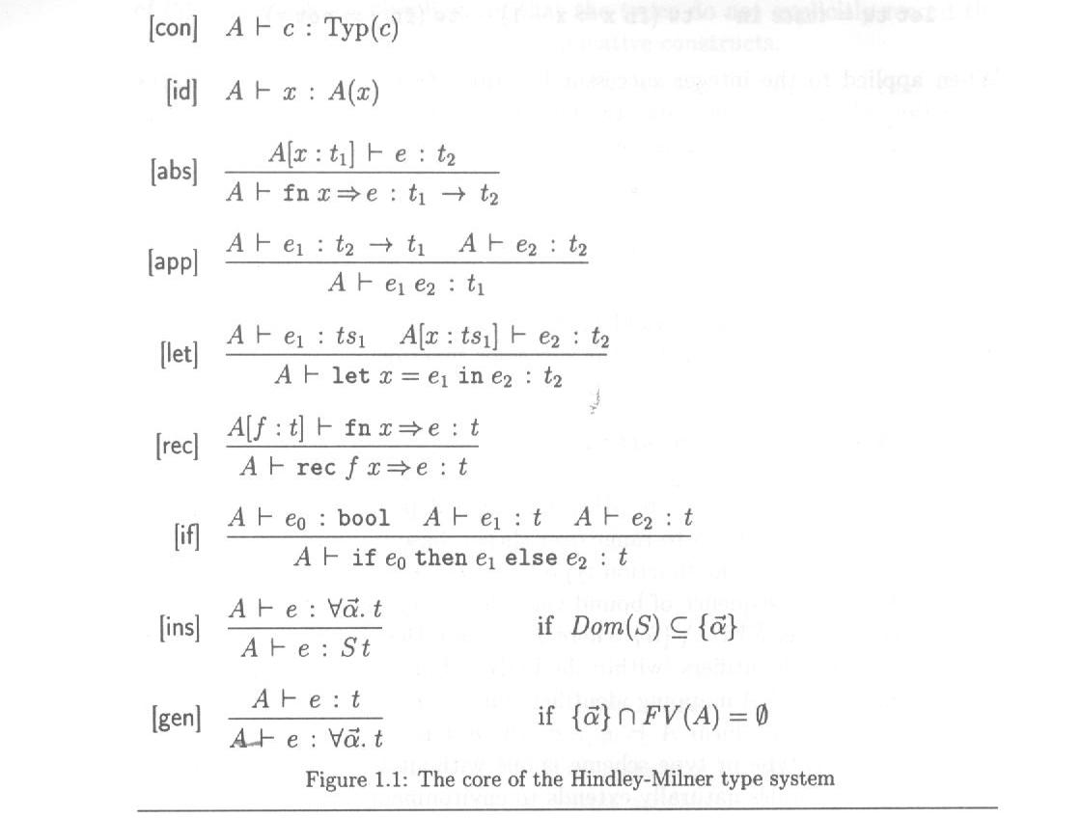
Hindley-Milner type system
Type and Effect Systems. Amtoft T., Nielson F, Nielson H. R.

Slide 28
Hindley-Milner type system
Type and Effect Systems. Amtoft T., Nielson F, Nielson H. R.
A is an environment that maps names to inferred types

Slide 29
Hindley-Milner type system
Type and Effect Systems. Amtoft T., Nielson F, Nielson H. R.
Symbol├ denotes a type judgement. For example, A├ e : t means that the type of e is t under environment A

Slide 30
Hindley-Milner type system
Type and Effect Systems. Amtoft T., Nielson F, Nielson H. R.

Slide 31
Hindley-Milner type system
Type and Effect Systems. Amtoft T., Nielson F, Nielson H. R.

Slide 32
Exercise
Type check the following functions:
let twice = fn f => fn x => f (f x) in twice k
rec fac n =
if n == 1
then 1
else n * fac (n – 1)

Slide 33
Algorithm W
Collect type (equality) constraints
Unify type expressions
Identify equivalent classes of type variables
Choose representative for each class and remove equivalent variables
Report type for each term

Slide 34
Type checking
Important static technique to detect simple kinds of errors in programs
  Typically sound but can report alarms on valid programs (incomplete)

Slide 35
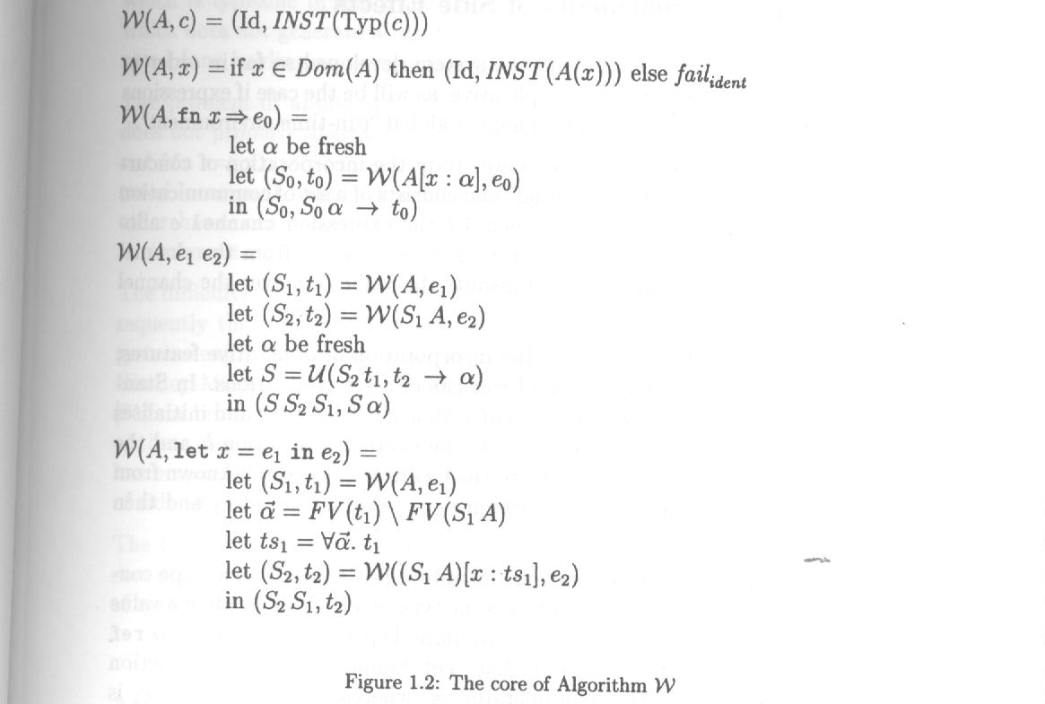
Type inference algo W
Type and Effect Systems. Amtoft T., Nielson F, Nielson H. R.

Slide 36
Type inference algo W
W is the type inference procedure. It takes environment A and expression e as input and returns a substitution S and inferred type t as output.
Type and Effect Systems. Amtoft T., Nielson F, Nielson H. R.

Slide 37
Type reconstruction algo W
W(t1,t2) is a unification procedure that returns a substitution S such that St1 = St2.
Type and Effect Systems. Amtoft T., Nielson F, Nielson H. R.

Slide 38
Other type systems
Dependent types
Intersection types
Union types

