Slide 1

Soot Basics
http://pan.cin.ufpe.br
Based on Soot’s PLDI03 tutorial and survival guide
(http://www.sable.mcgill.ca/soot/tutorial/index.html)
…with assistance of Mateus Borges

Slide 2
Agenda
Intermediate representations
Data structures
Unit graph and Boxes
Intraprocedural analysis

Slide 3
Intermediate representations
Baf: more compact representation of bytecode (no cte. pool and variation of same instruction)
Jimple: stackless Java with 3-addr. repr.
Shimple: Jimple + SSA
Others: Grimp and Dava

Slide 4
Sample: Java
public class Foo {
public static void main(String[] args) {
Foo f = new Foo();
int a = 7;
int b = 14;
int x = (f.bar(21) + a) * b;
}
public int bar(int n) { return n + 42; }
}

Slide 5
Try yourself…
java soot.Main –f baf Foo
writes baf code to sootoutput/Foo.baf

Slide 6
Baf
public static void main(java.lang.String[]) {
word r0;
r0 := @parameter0: java.lang.String[];
new sample.Foo;
dup1.r;
specialinvoke <sample.Foo: void <init>()>;
push 21;
virtualinvoke <sample.Foo: int bar(int)>;
push 7;
add.i;
push 14;
mul.i;
store.i r0;
return;
}
public int bar(int) {
word r0, i0;
r0 := @this: sample.Foo;
i0 := @parameter0: int;
load.i i0;
push 42;
add.i;
return.i;
}

Slide 7
Jimple
public static void main(java.lang.String[]) {
java.lang.String[] r0;
Foo $r1, r2;
int i0, i1, i2, $i3, $i4;
r0 := @parameter0: java.lang.String[];
$r1 = new Foo;
specialinvoke $r1.<Foo: void <init>()>();
r2 = $r1;
i0 = 7;
i1 = 14;
// InvokeStmt
$i3 = virtualinvoke r2.<Foo: int bar()>(21);
$i4 = $i3 + i0;
i2 = $i4 * i1;
return;
}
public int bar() {
Foo r0;
int i0, $i1;
r0 := @this: Foo; // IdentityStmt
i0 := @parameter0: int; // IdentityStmt
$i1 = i0 + 21; // AssignStmt
return \$i1; // ReturnStmt
}

Slide 8
Sample: Java
public int test() {
int x = 100;
while(as_long_as_it_takes) {
if(x < 200)
x = 100;
else
x = 200;
}
return x;
}

Slide 9
Shimple
public int test() {
ShimpleExample r0;
int i0, i0_1, i0_2, i0_3;
boolean $z0;
r0 := @this: ShimpleExample;
(0) i0 = 100;
label0:
i0_1 = Phi(i0 #0, i0_2 #1, i0_3 #2);
$z0 = r0.<ShimpleExample: boolean as_long_as_it_takes>;
if $z0 == 0 goto label2;
if i0_1 >= 200 goto label1;
i0_2 = 100;
(1) goto label0;
label1:
i0_3 = 200;
(2) goto label0;
label2:
return i0_1;
}

Slide 10
Command-line optimization…
java soot.Main -W -app -f jimple
-p jb use-original-names:true
-p cg.spark on
-p cg.spark simplify-offline:true
-p jop.cse on
-p wjop.smb on -p wjop.si off
Foo
Starting at Foo.class, process all reachable classes in an interprocedural fashion and produce Jimple as output for all application classes.

Slide 11
Command-line optimization…
java soot.Main -W -app -f jimple
-p jb use-original-names:true
-p cg.spark on
-p cg.spark simplify-offline:true
-p jop.cse on
-p wjop.smb on -p wjop.si off
Foo
When producing the original Jimple from the
class files, keep the original variable names, if
available in the attributes (i.e. class file produced
with javac -g).

Slide 12
Command-line optimization…
CHA, spark, and paddle are the options of points-to analysis. paddle is context-sensitive.
java soot.Main -W -app -f jimple
-p jb use-original-names:true
-p cg.spark on
-p cg.spark simplify-offline:true
-p jop.cse on
-p wjop.smb on -p wjop.si off
Foo
Use Spark for points-to analysis and call graph,
with Spark simplifying the points-to problem by
collapsing equivalent variables. Note: on is a short form for enabled:true.

Slide 13
Command-line optimization…
java soot.Main -W -app -f jimple
-p jb use-original-names:true
-p cg.spark on
-p cg.spark simplify-offline:true
-p jop.cse on
-p wjop.smb on -p wjop.si off
Foo
Turn on the intra and interprocedural opt. phases (-W). Enable common sub-expression elimination (cse). Enable static method binding (smb) and disable static inlining (si).

Slide 14
For building your analysis or transformation, you will need to use the programmatic interface. Need to know the basic data structures!
Hint: you may want to look how soot.Main operates to setup parts of it (e.g., Paddle)

Slide 15
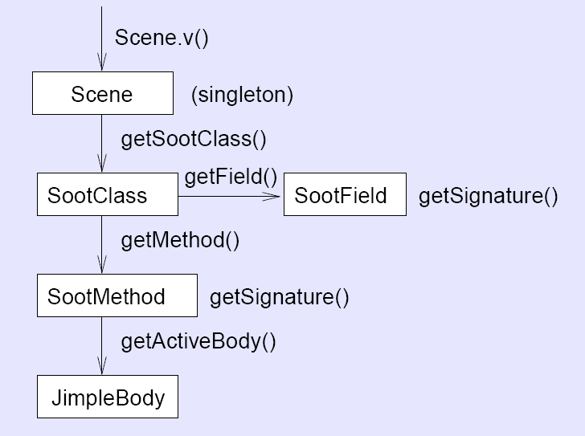
Main Soot classes

Slide 16
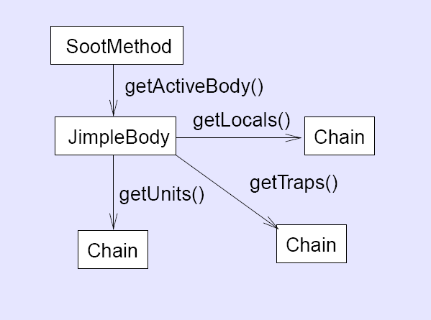
Method body

Slide 17
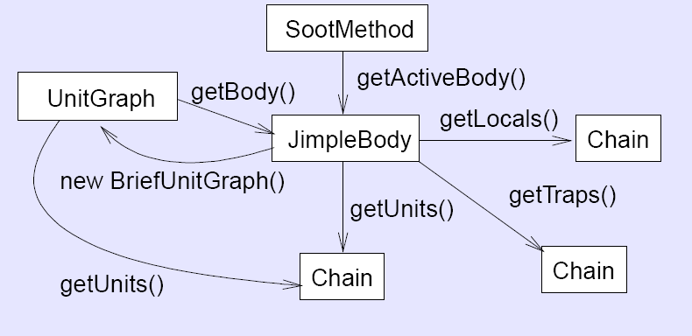
Unit graph (CFG)
Class Chain is a SOOT implementation of linked list

Slide 18
Example
public static void main(String[] _args) {
if (_args.length == 0) {
System.out.println("Usage: java Runnner class_to_analyse");
System.exit(0);
}
SootClass sClass = Scene.v().loadClassAndSupport(_args[0]);
sClass.setApplicationClass();
List<SootMethod> methods = sClass.getMethods();
for (SootMethod method : methods) {
Body body = method.retrieveActiveBody();
UnitGraph graph = new ExceptionalUnitGraph(body);
ReachingDefinitions analysis = new SimpleReachingDefinitions(graph);
for (Unit unit: graph) {
List<Definition> in = analysis.getReachingDefinitionsBefore(unit);
List<Definition> out = analysis.getReachingDefinitionsAfter(unit);
...
}
…
}
…
}

Slide 19
Operations on UnitGraph
getBody()
getHeads()
getTails()
getPredsOf(u)
getSuccsOf(u)
getExtendedBasicBlockPathBetween(from, to)

Slide 20
Boxes of a Unit
Finer access to information
getUseBoxes()
getDefBoxes()
getUseAndDefBoxes()
getBoxesPointingToThis()
removeBoxesPointingToThis()

Slide 21
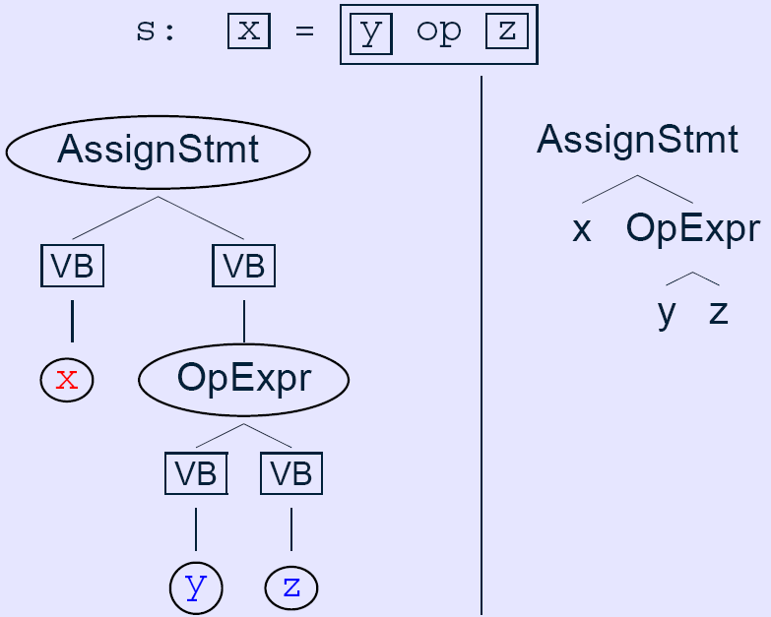
Box: Data Encapsulation
Value Box

Slide 22
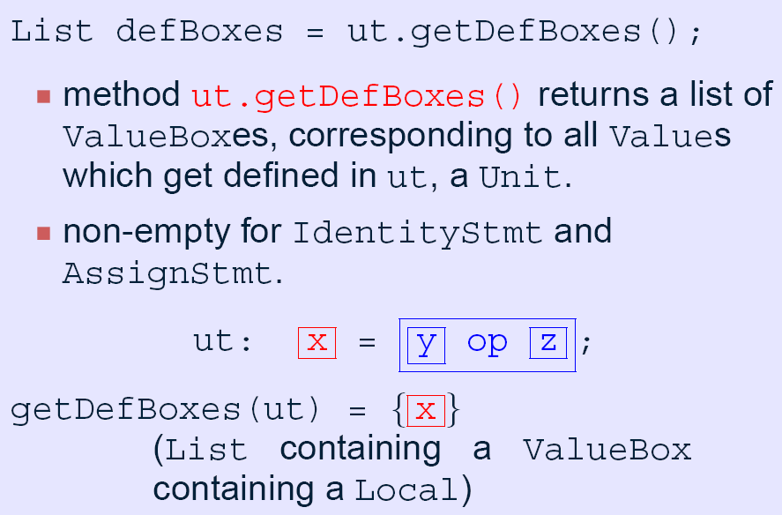
Def Boxes

Slide 23
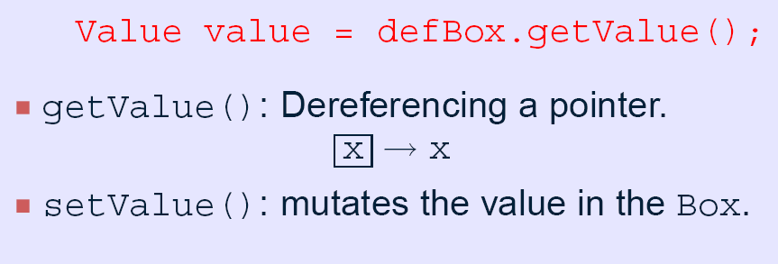
The value of a Value Box

Slide 24
Use boxes
Similar to def boxes. Example:

Slide 25
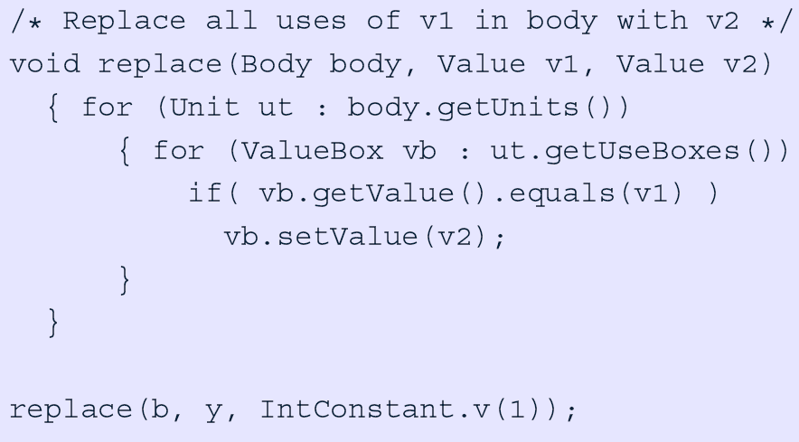
Example
Convention for factories

Slide 26
INTRAPROCEDURAL ANALYSIS

Slide 27
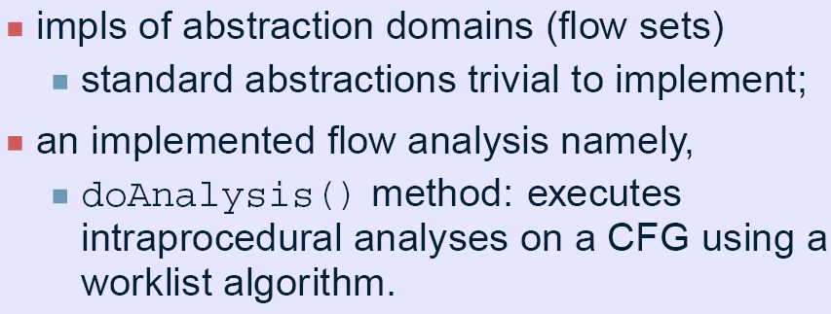
Soot provides…

Slide 28
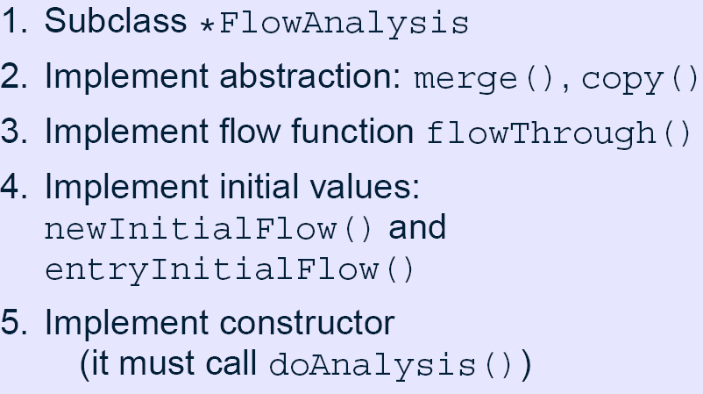
Soot requires…

Slide 29
AbstractFlowAnalysis.merge(...)
Merges in1 and in2 sets, putting result into out
protected abstract void merge(A in1, A in2, A out);
Typically a FlowSet implementation
in1
out
in2
Direction of data flow

Slide 30
AbstractFlowAnalysis.copy(...)
Creates a copy of source in dest
protected abstract void copy(A source, A dest);
source
dest

Slide 31
FlowAnalysis.flowThrough(...)
Transfers data flow info across a node
protected abstract void flowThrough(A in, N d, A out);
This is where your “kill” and “gen” methods are defined
in
out
d

Slide 32
FlowAnalysis.newInitialFlow(...)
Initial abstract value associated to each unit, except entry node
protected abstract A newInitialFlow();

Slide 33
FlowAnalysis.entryInitialFlow(...)
Abstract value associated to entry node
protected abstract A entryInitialFlow();
Node may be the start or end nodes of the CFG, depending on whether it is a forward or backward analysis.

Slide 34
Examples
Check the course webpage for sample of examples. Sliced from:
  http://www.brics.dk/SootGuide/sootsurvivorsguideexamples.tar.gz

Slide 35
POINTS-TO: HOW TO USE

Slide 36
CHA, SPARK, and PADDLE
CHA: assumes variable can point to every other
SPARK: Subset-based like Andersen’s. But context-insensitive.
PADDLE: context-sensitive version of SPARK

Slide 37
Example: Container class
(1)
public class Container {
private Item item = new Item();
void setItem(Item item) {
this.item = item;
}
Item getItem() {
return this.item;
}
}
public class Item {
Object data;
}

Slide 38
Example: Container client
(2)
(3)
public void go(){
Container c1 = new Container();
Item i1 = new Item();
c1.setItem(i1);
Container c2 = new Container();
Item i2 = new Item();
c2.setItem(i2);
Container c3 = c2;
}

Slide 39
SPARK and PADDLE
points-to(c1) = {a}
points-to(i1)={b}
points-to(c2) = points-to(c3) = {c}
points-to(i2)={d}
points-to(c1.item) = points-to(c2.item) = points-to(c3.item) = {b,d}
SPARK
points-to(c1) = {a}
points-to(i1)={b}
points-to(c2) = points-to(c3) = {c}
points-to(i2)={d}
points-to(c1.item) = {b}
points-to(c2.item) = points-to(c3.item) = {d}
PADDLE

Slide 40
SPARK and PADDLE
SPARK is context-insensitive: cannot distinguish the two calls to setItem
points-to(c1) = {a}
points-to(i1)={b}
points-to(c2) = points-to(c3) = {c}
points-to(i2)={d}
points-to(c1.item) = points-to(c2.item) = points-to(c3.item) = {b,d}
SPARK
points-to(c1) = {a}
points-to(i1)={b}
points-to(c2) = points-to(c3) = {c}
points-to(i2)={d}
points-to(c1.item) = {b}
points-to(c2.item) = points-to(c3.item) = {d}
PADDLE

Slide 41
http://pan.cin.ufpe.br

