Slide 1

Partial correctness
http://pan.cin.ufpe.br

Slide 2
Intuition
Program and mathematical formula are similar. Both manipulate symbols and have precise syntax and semantics.
Encode program state as a predicate and statements as predicate transformers.

Slide 3
For verification…
Reason about programs as logical formulae
Derive formula from program. If program is incorrect should find contradictions!

Slide 4
Basis: Floyd-Hoare Triples
{P} S {Q}
P and Q denote pre and post conditions on S

Slide 5
Semantic distinction
{P} S {Q}
Partial correctness: For all states that satisfy P, if S terminates, then Q must hold in that state
Total correctness: For all states that satisfy P, then S terminates and the resulting state satisfies Q

Slide 6
Is this valid?
{true} while (true) x:=2 {1==2}

Slide 7
Is this valid?
{true} while (true) x:=2 {1==2}
Answer: Only under partial correctness since false (due to non termination) implies absurd

Slide 8
Example
{y<=3} x:=2*y+1 {x<=7 and y<=3}

Slide 9
Exercise
Propose other preconditions P that makes this post condition to hold
{P?} x:=2*y+1 {x<=7 and y<=3}

Slide 10
Definition: Weaker formula
A formula A is weaker than B if B -> A. Given a set of formulas {A1,…,An}, Ai is the weakest in the set if Aj -> Ai for all j in [1,n].
Definition of stronger is symmetric.

Slide 11
Back to previous exercise
Propose other preconditions P that makes this post condition to hold
{P?} x:=2*y+1 {x<=7 and y<=3}
We want to find the weakest predicate P (i.e., permissive/liberal/general) that is strong enough to make post condition hold.

Slide 12
Axiomatic semantics of programs
Define semantics of each construct in terms of its effects on global state
  Most popular definitions: wp and sp
  Basis to automated derivation of pgm. obligations

Slide 13
WP and SP
wp (weakest precondition): Derive most general (weakest) accepting condition on state that results in correct executions
sp (strongest postcondition): Derive most specific (strongest) condition that holds in every final states from correct executions

Slide 14
Fragment of Pascal
[ASSIGN] wp(x:=t, p(x)) = p(x) {x <- t}
[COMP] wp(S1;S2, q) = wp(S1,wp(S2,q))
[COND] wp(if B then S1 else S2, q) = B-> wp(S1,q) and not B -> wp(S2,q)
[WHILE] wp(while B do S, q) = (not B -> q) and B -> wp(S; while B do S, q)
Oops… Cannot mechanically compute it!

Slide 15
Exercise: Compute the following
wp(x:=x+1; y:=y+2, x < y)
wp(x:=x+1; y:=y+2, x = (b - y)*a)
wp(if y=0 then x:=0 else x:=y+1, x = y)

Slide 16
Verification Conditions (VCs)
S ; assert Q
assume P ; S
{?} S {Q}
{P} S {True}
{P} S {Q}
{P => P0} S {True}

Slide 17
Verification Conditions (VCs)
assume P; S ; assert Q
{P} S {Q}
{P => P0} S {Q}

Slide 18
VC generators
One rule for each language statement
Conceptually, one can derive a predicate for entire program with assistance of rules
S₁ ; S₂ ; … ; S_{n}
statements
predicates
P₁ P₂ P₃ P_{n-1} P_{n}

Slide 19
VC generators
One rule for each language statement
Conceptually, one can derive a predicate for entire program with assistance of rules
S₁ ; S₂ ; … ; S_{n}
statements
predicates
P₁ P₂ P₃ P_{n-1} P_{n}
Interested reader should look George Necula’s work on proof-carrying code and also the Spec# and ESCJava tools.

Slide 20
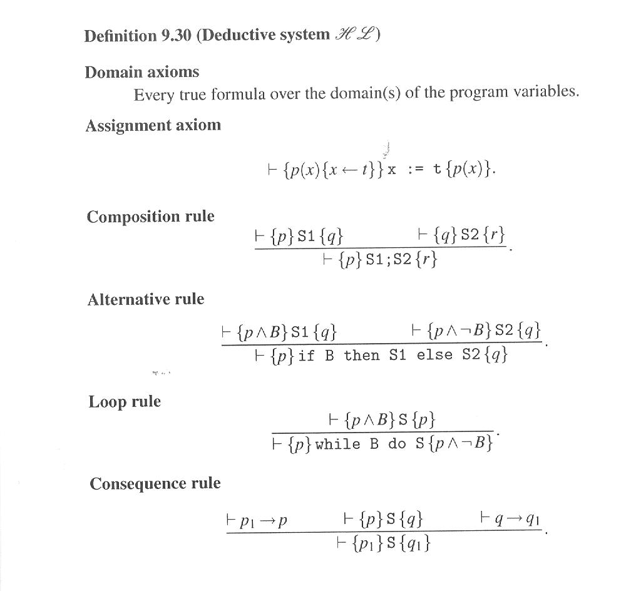
Deductive System
Mathematical Logic for Computer Science. Mordechai Ben-Ari, Springer

Slide 21
Exercise
Generate weakest precondition for the program below to validate the assertion
x := 0
y := b;
while y <> 0 do
begin x:= x + a; y:= y – 1 end;
assert x = a * b

Slide 22
Conclusions
Partial correctness is a cornerstone in program language and verification
Very important to note. Not automatic!
  Manual generation of loop invariants is costly
  First-order logics alone is undecidable

