Slide 1

Introduction
http://pan.cin.ufpe.br
Notes:
Sist. Tipos java: giov + arrays
As => numbers

Slide 2
Definition of Static Analysis (SA)
Technique to extract information at compile-time from a computer program

Slide 3
Enabling technology…
…to different SE and PL fields. In particular:
  Software Design
  Software Verification

Slide 4
Several Purposes
Prove correctness
  e.g., show that program has no null derefs, etc.
Guide other tools
  e.g., integration testing from dependence graphs
Assist human activity
  e.g., find bad smells, find code clones, report quality metrics, report code dependencies etc.

Slide 5
Several Forms
Pattern matching
Type checking
Partial correctness
Symbolic execution
Dataflow analysis
Our focus
Notes:
Reason to focus on dataflow. (1) Classical technique; student must know. (2) Others are more focused on verification. Type checking verification of very simple properties. Symbolic execution (testing) of more elaborated ones but, off course, is not as efficient as type checking.

Slide 6
Several Forms: By Example
Match this anti-pattern against this program:
Type check the function abstractions:
BAD_PRACTICE: String comparison with ==
public static void main(String[] args) {
if (args != null &&
args.length > 1 &&
args[0] == “option1”) {…}}
lambda f g h . (f g) (h + 3)
lambda f g h . f (g (h + 3))
lambda f . f f

Slide 7
Several Forms: By Example
Generate predicate P and check assertion:
Execute symbolically the method:
public static void sort(int[] x) {
… {P} assert(P => Q)
// Q = x is permutation of old-x &&
// x is ascending
}
public static void foo(int x) {
if (x > 10) { … }
else { ERROR! }
}

Slide 8
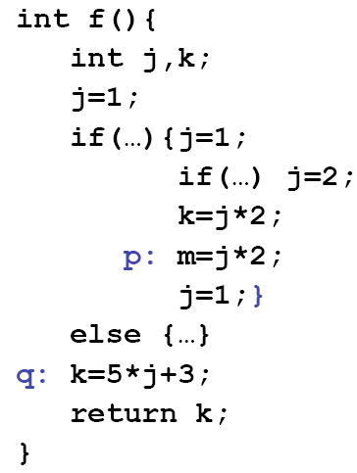
Several Forms: Dataflow analysis
Do any of j-manipulating expressions denote compile-time constants?
*Example from Barbara Ryder’s ACACES Summer School Lecture Notes:
http://www.cs.rutgers.edu/~ryder/ACACES07/

Slide 9
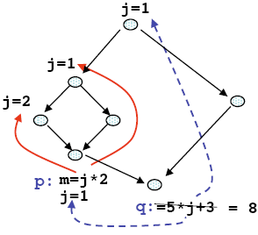
Several Forms: Dataflow analysis
*Example from Barbara Ryder’s ACACES Summer School Lecture Notes:
http://www.cs.rutgers.edu/~ryder/ACACES07/

Slide 10
Several Forms: Dataflow analysis
Direction of arrows denote control and data dependency, respectively!
*Example from Barbara Ryder’s ACACES Summer School Lecture Notes:
http://www.cs.rutgers.edu/~ryder/ACACES07/

Slide 11
VCG and Checking
Type checking
No silver bullet! There are compromises. But several tools can successfully use them.
Dataflow analysis
Pattern matching
Symbolic Execution

Slide 12
Success Cases
Popular Tools
  Case 1: Lint (dataflow and pattern matching)
  Case 2: PReFIX (symbolic execution)
  Case 3: FindBugs (mostly pattern matching)
Huge Market!
  Coverity: http://www.coverity.com
  GrammaTech: http://www.grammatech.com
  KlocWork: http://www.klocwork.com
  Parasoft: http://www.parasoft.com
  Semmle: http://semmle.com

Slide 13
Case 1: Lint
[Johnson, Bell Lab’s TR65 1977]
Problem: Find common error patterns in C code
  E.g., enforces strict typing rules (function calls and casting), use without def, def without use, functions without used, portability issues, etc.
Motivation: C is weakly typed
Proposal: Use compiler’s intra-procedural (cheap) analysis
Comment: Use regularly or on mature codebase to avoid a warning flood
See: http://www.pdc.kth.se/training/Tutor/Basics/lint/index-frame.html

Slide 14
Case 2: PReFIX
[Bush et al., SPE 2000]
Problem: Find common errors in C code.
  E.g., memory misuse (null de-refs and leaks), uninitialized variables, library idioms, etc.
Motivation: Lint-like tools report many false alarms
Proposal: Simulate runs at compile-time
  Symbolic execution of C programs. Use heuristics to:
    Select inter-procedural paths to visit
    Filter/Sort warning reports

Slide 15
Case 3: FindBugs
[Hovemeyer and Pugh, OOPSLA 2004]
Problem: Programmers repeat standard errors
Proposal: Look for code anti-patterns (error-prone code, inefficient, etc.)
  The FindBugs took looks for bytecode patterns
Notes:
not

Slide 16
Case 3: FindBugs
[Hovemeyer and Pugh, OOPSLA 2004]
Unguarded logging affects performance!
public void visit(Code code) {
seenGuardClauseAt = Integer.MIN_VALUE;
logBlockStart = 0;
logBlockEnd = 0;
super.visit(code);
}
public void sawOpcode(int seen) {
if ("cbg/app/Logger".equals(classConstant) && seen == INVOKESTATIC &&
"isLogging".equals(nameConstant) && "()Z".equals(sigConstant)) {
seenGuardClauseAt = PC;
return;
}
if (seen == IFEQ && (PC >= seenGuardClauseAt + 3 && PC < seenGuardClauseAt + 7)) {
logBlockStart = branchFallThrough;
logBlockEnd = branchTarget;
}
if (seen == INVOKEVIRTUAL && "log".equals(nameConstant)) {
if (PC < logBlockStart || PC >= logBlockEnd) {
bugReporter.reportBug(new BugInstance("CBG_UNPROTECTED_LOGGING", HIGH_PRIORITY)
.addClassAndMethod(this).addSourceLine(this));
}
}
}

Slide 17
Case 3: FindBugs
[Hovemeyer and Pugh, OOPSLA 2004]
Several others query languages: SeemleCode [Verbaere et al., OOPSLA 2007], Design Wizard [Brunet et al., ICSE 2009], etc.
public void visit(Code code) {
seenGuardClauseAt = Integer.MIN_VALUE;
logBlockStart = 0;
logBlockEnd = 0;
super.visit(code);
}
public void sawOpcode(int seen) {
if ("cbg/app/Logger".equals(classConstant) && seen == INVOKESTATIC &&
"isLogging".equals(nameConstant) && "()Z".equals(sigConstant)) {
seenGuardClauseAt = PC;
return;
}
if (seen == IFEQ && (PC >= seenGuardClauseAt + 3 && PC < seenGuardClauseAt + 7)) {
logBlockStart = branchFallThrough;
logBlockEnd = branchTarget;
}
if (seen == INVOKEVIRTUAL && "log".equals(nameConstant)) {
if (PC < logBlockStart || PC >= logBlockEnd) {
bugReporter.reportBug(new BugInstance("CBG_UNPROTECTED_LOGGING", HIGH_PRIORITY)
.addClassAndMethod(this).addSourceLine(this));
}
}
}

Slide 18
Remember
Pattern matching
Type checking
Partial correctness
Symbolic execution
Dataflow analysis
Our focus
Notes:
Reason to focus on dataflow. (1) Classical technique; student must know. (2) Others are more focused on verification. Type checking verification of very simple properties. Symbolic execution (testing) of more elaborated ones but, off course, is not as efficient as type checking.

Slide 19
Soundness and Completeness
Soundness:
Analysis reports no errors
⇒ Really are no errors
Completeness:
Analysis reports an error
⇒ Really is an error
error
error
ok
ok
Sound analysis
Complete analysis
*Courtesy of Claus Brabrand : http://www.itu.dk/people/brabrand/UFPE/Data-Flow-Analysis/

Slide 20
Soundness and Completeness
Soundness: No false negatives
  There are no escaped errors. We say that a sound analysis is conservative (pessimistic).
Completeness: No false positives
Definitions vary from field to field. This applies in the context of verification.

Slide 21
Type checking Java
Sound
Rejects all type-invalid programs
InComplete
Rejects few type-valid programs
void m(Object o) {
if (s instanceof String) {
s.indexOf(“.”);
}
}
void m(Thread t) {…
t.remove();
}
Notes:
Rejects first as there is no remove method in class Thread. Rejects second but it could have accepted it as the context says the class is of String type.

Slide 22
FAQ
My analysis is sound and reports an error!
  Is the error real? MAYBE NOT (assume incomplete)
My analysis is sound and reports no error!
  Is my program correct w.r.t. that property? YES
My analysis is complete and reports an error!
  Is the error it reports a real error? YES
My type checker is conservative!
  Can it accept programs with type errors? NO
  Can it reject type-correct programs? YES, IF INCOMPLETE

Slide 23
Inaccuracy
Results from the decisions of the analyzer to deal with performance and hard problems
  Pessimistic (can result in false positives)
  Optimistic (can result in missed errors)

Slide 24
Reality: No Silver Bullet
Testing
Sound static analysis
optimistic inaccuracy
pessimistic inaccuracy
Complexity of
property + program

Slide 25
Reality: No Silver Bullet
Ideal (but unrealistic) scenario: Accurate results regardless of complexity.
optimistic inaccuracy
pessimistic inaccuracy
Complexity of
property + program

Slide 26
Reality: No Silver Bullet
Practice 1: Sacrifice soundness in favor of decidability
optimistic inaccuracy
pessimistic inaccuracy
Complexity of
property + program

Slide 27
Reality: No Silver Bullet
Practice 2: Sacrifice completeness in favor of scalability
optimistic inaccuracy
pessimistic inaccuracy
Complexity of
property + program
© Marcelo d’Amorim 2010

Slide 28
In Summary…
Needs to simplify (approximate) results to deal with undecidable properties and/or large programs

Slide 29
Language Features and Imprecision
Language features lead to imprecise results
  Reflection
  Pointers
  I/O
Better precision comes with higher cost!

Slide 30
Example: Reachable Definitions
*Example from Barbara Ryder’s ACACES Summer School Lecture Notes:
http://www.cs.rutgers.edu/~ryder/ACACES07/

Slide 31
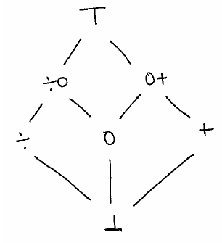
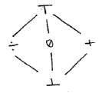
Dataflow Analysis
*Courtesy of Claus Brabrand : http://www.itu.dk/people/brabrand/UFPE/Data-Flow-Analysis/
Program:
1. Control-flow graph:
5. Solve rec. equations…:
x = 0;
do {
x = x+1;
} while (…);
output x;
T⁰( )
T¹( )
T²( )
T³( )
=
T⁴( )
T⁵( )
a =
x = 0;
b =
c =
ANOTHER FIXED POINT
x = x+1;
LEAST FIXED POINT
d =
3. Recursive equations:
e =
a =
b = f_{x=0}(a)
c = b d
d = f_{x=x+1}(c)
e = d
output x;

2. Transfer functions:
T
T
T
T
T
T
f_{x=0}(l ) =
f_{x=x+1}(l ) = l ⊕_{L}
solution
≈
4. one ”big” transfer function:
T((a,b,c,d,e)) = ( ,f_{x=0}(a),b d,f_{x=x+1}(c),d)
…over a ”big”
power-lattice:
|VAR|*|PP| = 1*5 = 5

Slide 32
Reachable Definitions in SOOT
public class SimpleReachingDefinitions implements ReachingDefinitions {
private HashMap<Unit,List<Definition>> unitToDefinitionAfter;
private HashMap<Unit,List<Definition>> unitToDefinitionBefore;
public SimpleReachingDefinitions(DirectedGraph<Unit> graph) {/*WORK*/}
public List<Definition> getReachingDefinitionsAfter(Unit _unit) {
return this.unitToDefinitionAfter.get(_unit);}
public List<Definition> getReachingDefinitionsBefore(Unit _unit) {
return this.unitToDefinitionBefore.get(_unit);}
}
class SimpleReachingDefinitionsAnalysis extends ForwardFlowAnalysis<Unit, FlowSet> {
private FlowSet emptySet;
public SimpleReachingDefinitionsAnalysis(DirectedGraph<Unit> _graph) { /*INIT*/}
protected void copy(FlowSet _source, FlowSet _dest) { …}
protected void copy(FlowSet _source, FlowSet _dest) { …}
protected void merge(FlowSet _source1, FlowSet _source2, FlowSet _dest) { ...}
protected FlowSet entryInitialFlow() { ...}
protected FlowSet newInitialFlow() { ...}
protected void flowThrough(FlowSet _source, Unit _unit, FlowSet _dest) {...}
private void kill(FlowSet _source, Unit _unit, FlowSet _dest) {...}
private bdef(FlowSet _source, Unit _unit, FlowSet _dest) {...}
}

Slide 33
Reachable Definitions in SOOT
public class SimpleReachingDefinitions implements ReachingDefinitions {
private HashMap<Unit,List<Definition>> unitToDefinitionAfter;
private HashMap<Unit,List<Definition>> unitToDefinitionBefore;
public SimpleReachingDefinitions(DirectedGraph<Unit> graph) {/*WORK*/}
public List<Definition> getReachingDefinitionsAfter(Unit _unit) {
return this.unitToDefinitionAfter.get(_unit);}
public List<Definition> getReachingDefinitionsBefore(Unit _unit) {
return this.unitToDefinitionBefore.get(_unit);}
}
class SimpleReachingDefinitionsAnalysis extends ForwardFlowAnalysis<Unit, FlowSet> {
private FlowSet emptySet;
public SimpleReachingDefinitionsAnalysis(DirectedGraph<Unit> _graph) { /*INIT*/}
protected void copy(FlowSet _source, FlowSet _dest) { …}
protected void copy(FlowSet _source, FlowSet _dest) { …}
protected void merge(FlowSet _source1, FlowSet _source2, FlowSet _dest) { ...}
protected FlowSet entryInitialFlow() { ...}
protected FlowSet newInitialFlow() { ...}
protected void flowThrough(FlowSet _source, Unit _unit, FlowSet _dest) {...}
private void kill(FlowSet _source, Unit _unit, FlowSet _dest) {...}
private bdef(FlowSet _source, Unit _unit, FlowSet _dest) {...}
}
Programmer specifies how to transfer information across edges of a flow graph.

Slide 34
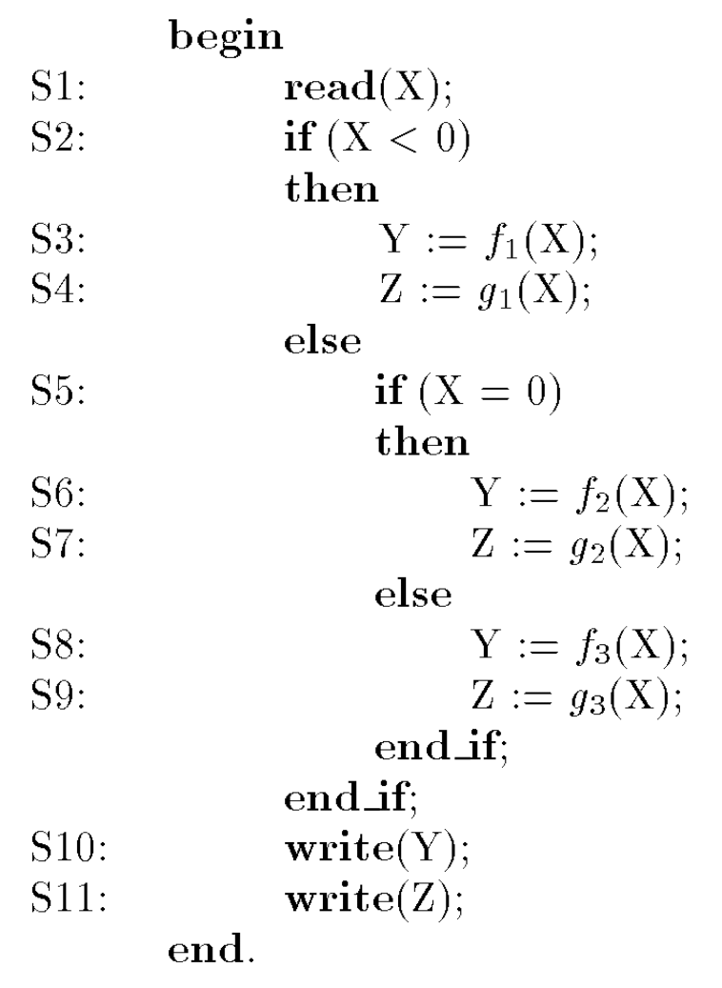
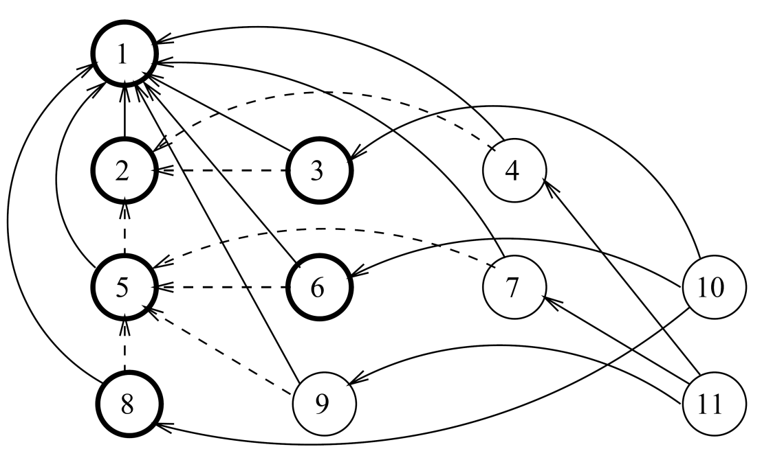
Basic terminology: dependency
On Control: dominance
On Data: def-use, use-def
PROGRAM DEPENDENCE GRAPH (PDG)
From “Dynamic Program Slicing”, Agrawal and Horgan, PLDI’90

Slide 35
Basic terminology: dependency
On Control
  Dominance
  Post-dominance
entry
d
n
n
pd
exit

Slide 36
Dataflow analysis terminology
[“A few billion LOC latter”, Bessey et al., CACM 2010]
[…] checkers […] traverse program paths in a forward direction (flow-sensitive), going across function calls (inter-procedural) while keeping track of call-site-specific information (context-sensitive) and […] detect when a path is infeasible (path-sensitive).

Slide 37
Final Question
Why SA is not more intensively used?
  Engineer: Takes too long to run
  Theoretician: Property to check is undecidable
  Econ. 1: It is cheaper to train people
  Econ. 2: Defeats purp.; high number of false alarms

Slide 38
http://pan.cin.ufpe.br
Program analysis (dynamic, static, mixed) is promising. But one needs to learn when and how to apply it. This is one of the goals of this course.

Slide 39
Proofs and Decidability (1/3)
One can use axiomatic semantics of Java to derive a predicate that holds at the exit of sort
Such predicate can assist the proof of
public static void sort(int[] numbers) {
for (int i = 0; i < numbers.length; i++) {
int copyNumber = numbers[i];
int j = i;
while (j > 0 && copyNumber < numbers[j-1]) {
numbers[j] = numbers[j-1]; j--;
}
numbers[j] = copyNumber;
}
}
forall as . ascending(sort(as)) && permutation(sort(as),as)

Slide 40
Proofs and Decidability (2/3)
FOL is undecidable in general
User needs to provide loop invariants

Slide 41
Proofs and Decidability (3/3)
Note 1: symbolic execution can show that no errors exist up to given bounds of array sizes
Note 2: symbolic execution is very expensive.

