Slide 1

Interprocedural analysis
http://pan.cin.ufpe.br

Slide 2
Intraprocedural analysis
Intraprocedural analysis considers the body of a single function
  Useful for many applications
    For instance, to identify local variable definition without use (or the contrary)
public void foo(int x) {
int tmp;
if (x > 10) { tmp = 10; … }
else { … }
… = tmp
}

Slide 3
Some applications require analyses across multiple functions. For instance, to identify methods that can read data that another writes.

Slide 4
Interprocedural analysis
Data flows across function calls
Naive solution: ???

Slide 5
Interprocedural analysis
Data flows across function calls
Naive solution: Inline all calls
  Limitations ???

Slide 6
Interprocedural analysis
Data flows across function calls
Naive solution: Inline all calls
  Limitations
    Program size “explodes” with number of call sites
    Does not handle recursion in general
      requires bounded unfolding of function declarations

Slide 7
Interprocedural analysis
Data flows across function calls
Naive solution: Inline all calls
  Limitations
    Program size “explodes” with number of call sites
    Does not handle recursion in general
      requires bounded unfolding of function declarations
May be good enough for you!

Slide 8
Classical approach
Build flow graph with special nodes+edges to propagate function call data

Slide 9
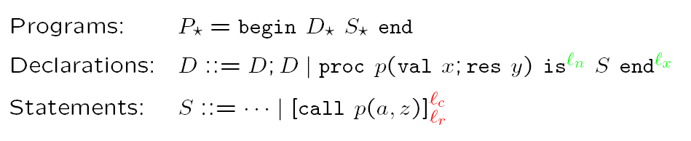
Syntax of language with procedures
*From Principles of Program Analysis, F. Nielson et al., Springer 2005

Slide 10
Flow graphs for programs
(as opposed to a procedure)
Needs to consider effects of
  Call
  Procedure entry
  Procedure exit
  Return
*From Principles of Program Analysis, F. Nielson et al., Springer 2005

Slide 11
Exercise
Build FG for the following program
begin
proc fib(val z, u, res v) is
if z < 3 then v := u + 1
else call fib(z-1,u,v); call fib(z-2,v,v)
end;
end

Slide 12
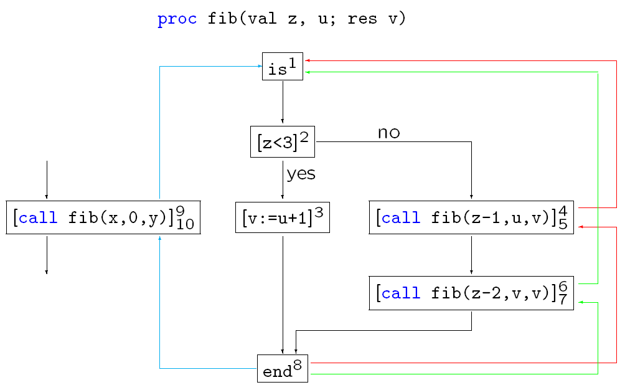
Program flow graph
*From Principles of Program Analysis, F. Nielson et al., Springer 2005

Slide 13
Data propagates across edges just as before. Intraprocedural analysis still applies for every non function-related node.

Slide 14
A problem to overcome…
Suppose this is part of one program flow graph. Can you see the problem in the way data may flow?
call site 1
call site 2
foo()

Slide 15
A problem to overcome…
call site 1
call site 2
foo()
This control path does not exist. Ignoring this issue may affect precision! Context sensitivity eliminates such data flows. But adds complexity to the analysis: impact on time/memory requirements.

Slide 16
A problem to overcome…
call site 1
call site 2
foo()
A context-sensitive analysis will only consider valid control paths in the flow graph

Slide 17
Quick Question
Would such invalid paths arise in the inline approach?
Notes:
No. The program is flat after complete inlining.

Slide 18
Context sensitive analysis
General approach: Encode context information with analysis information

Slide 19
Context sensitive analysis
General approach: Encode context information with analysis information
  At entry node, appends origin location
  At exit node, only transfer data that have flown from origin
call site 1
call site 2
foo()

Slide 20

Exercise
We have programs with integer variables and want to detect statically the signs they can hold. What lattice would you use?
*From Principles of Program Analysis, F. Nielson et al., Springer 2005
Notes:
Um elemento do lattice: {f1,f2,f3} onde f1 = {(x,+),(y,-),(z,0)}, f2 ={(x,0),(y,0),(z,0)}, e f3={(x,-),(y,-),(z,-)}

Slide 21

Exercise
One option…
This formulation allows one to associate signs of distinct variables.
*From Principles of Program Analysis, F. Nielson et al., Springer 2005
Notes:
Um elemento do lattice: {f1,f2,f3} onde f1 = {(x,+),(y,-),(z,0)}, f2 ={(x,0),(y,0),(z,0)}, e f3={(x,-),(y,-),(z,-)}

Slide 22

Context information in the lattice
Back to Detection of Signs Analysis
Data is labeled by calling context △.

Slide 23
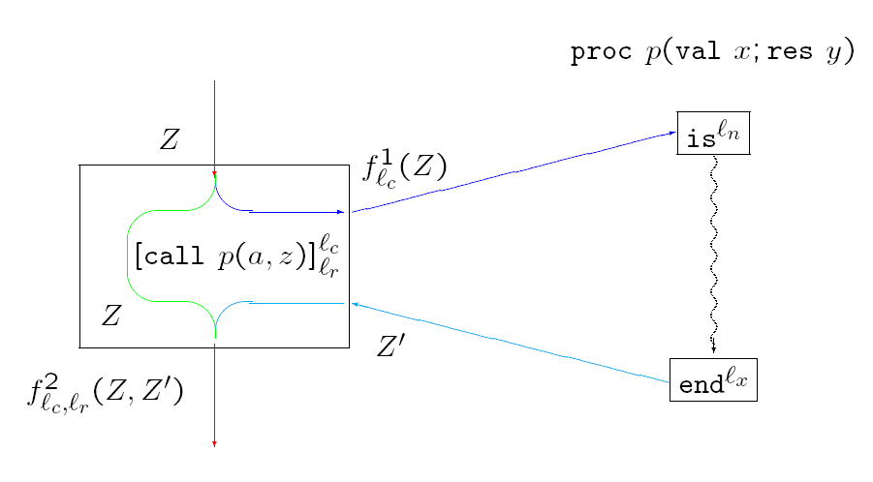
Transfer functions
*From Principles of Program Analysis, F. Nielson et al., Springer 2005

Slide 24

Transfer functions
For declarations
Two transfer functions
Define effect of entry (exit) at (from) p
For illustration purposes assume both function are identity
*From Principles of Program Analysis, F. Nielson et al., Springer 2005

Slide 25



Transfer functions
For calls
Transfer function for call:
Function f_{lc}“saves” calling context together with data
*From Principles of Program Analysis, F. Nielson et al., Springer 2005

Slide 26

Transfer functions
For calls
Transfer function for return
Function f_{lc,lr}“restores” context and only propagate data that correspond to the call
*From Principles of Program Analysis, F. Nielson et al., Springer 2005

Slide 27
Two standard encodings of context
Call strings
Assumption sets

Slide 28


Call Strings
String consisting of pending procedure call on the stack
Call strings of fib
  [], [9,4], [9,6], [9,4,4], [9,4,6], [9,6,4], [9,6,6], etc.
Unbounded ( ) or Bounded ( ) length

Slide 29
Call Strings
String consisting of pending procedure call on the stack
Call strings of fib
  [], [9,4], [9,6], [9,4,4], [9,4,6], [9,6,4], [9,6,6], etc.
Unbounded ( ) or Bounded ( ) length
Context is a stack of string elements, each denoting function calls.

Slide 30


Assumption Sets
Use abstract states to caracterize context
For instance, make △=
or △=

Slide 31
Flow sensitivity
Considers the order of statements
  Flow insensitive analysis produce same results for S;S’ and S’;S
So far, only flow sensitive examples

Slide 32
Example
begin
proc fib(val z) is
if z < 3 then call add(1)
else call fib(z-1); call fib(z-2)
end;
proc add(val u) is (y:=y+u; u:=0)
end;
y:=0; call fib(x)
end

Slide 33
What globals are updated?
Two auxiliary functions:
  AV: Name => P (Name)
  CP: Name => P (Name)
Defintion:
  IAV(p) = (AV(S) \ {x}) U U {IAV(p’) | p’ ∈ CP(s)}, where proc p(val x, res y) is S end
IAV(fib) = ( Ø \ {z}) U IAV(fib) U IAV(add)
IAV(add) = {y,u} \ {u}

Slide 34
Points-to Analysis
Analysis that computes a function
Null deref?
  null ∈pt(o)
Alias possible?
  pt(a) ∩ pt(b) ≠ Ø
  pt: Var => P (Loc)

Slide 35
Question
Points to set are typically large. For type safe languages, these sets can be significantly reduced. Why?
Notes:
Set will only admit location with consistent types

Slide 36
Points-to Analysis
Two algorithms for finding “points-to” sets:
  Andersen’s
  Steensgaard’s
possible seminar selection

Slide 37
Points-to Analysis
Main applications
  Null pointer analysis
  Shape analysis
  Mutability analysis
Important for interprocedural analysis. E.g., more detailed flow graphs for oo programs can be built by constraining the actual types of method callers.

Slide 38
APPLICATIONs OF STATIC ANALYSIS

Slide 39
Some applications
Change Impact Analysis
  Guide inspection, debugging, and testing activities
  See work of Barbara Ryder at Rutgers Univ.
Dataflow testing
  Test is “good” if exercises data dependency
  See work of Mauro Pezze at Politechnical de Milano

Slide 40
Some applications
Change Impact Analysis
  Guide inspection, debugging, and testing activities
  See work of Barbara Ryder at Rutgers Univ.
Dataflow testing
  Test is “good” if exercises data dependency
  See work of Mauro Pezze at Politechnical de Milano
Focus

Slide 41
Traditional dataflow
Check if test activates pair of def-use
  Variations: all pairs, all uses, all defs

Slide 42
Question
Why traditional dataflow testing may not be appropriate for oo programs?
Notes:
Set will only admit location with consistent types

Slide 43
Question
Why traditional dataflow testing may not be appropriate for oo programs?
Imagine the scenario where all fields are encapsulated with accessor methods (getters & setters). Dataflow adequacy will be vacuous (and trivial to obtain)!

Slide 44
Question
Why traditional dataflow testing may not be appropriate for oo programs?
Imagine the scenario where all fields are encapsulated with accessor methods (getters & setters). Dataflow adequacy will be vacuous (and trivial to obtain)!
Would that be a problem with a flat state (i.e., all state global no object)?

Slide 45
Data encapsulation
Encapsulation is key to information-hiding and advocated in OO programming

Slide 46
Contextual def-use associations
Stronger requirement: add context information to associations (test requirement)
  A contextual def-use association is a tuple (d,u,cd,cu)
  Example:
    (19,22,Storage::storeMsg()-> Storage::setStored(), Storage::getStored())
Context of definition and use
Distinguish from context-free associations in that invocations to accessors are mediated.

Slide 47
http://pan.cin.ufpe.br

