Slide 1
A Survey of the Research on Future internet architectures
Jianli Pan et al. IEEE Communications Magazine, July 2011 p. 26-36

Slide 2
Steps for a FIA
Innovations in various aspects of the Internet
Collaborative projects putting multiple innovations into an overall networking architecture
Testbeds for real-scale experimentation
It may take a few rounds or spirals to work out a future Internet architecture that can fit all the requirements.

Slide 3
Key Research Topics
Content- or data-oriented paradigms:
  It is desirable to change the architecture’s narrow waist from IP to the data or content distribution.
  Several research projects are based on this idea.
  Challenges:
    In data and content security and privacy,
    Scalability of naming and aggregation,
    Compatibility and co-working with IP, and
    Efficiency of the new paradigm.

Slide 4
Key Research Topics
Mobility and ubiquitous access to networks:
  mobility as the norm instead of an exception of the architecture
  Challenges:
    how to trade off mobility with scalability,
    security, and privacy protection of mobile users,
    mobile endpoint resource usage optimization,
    and so on.

Slide 5
Key Research Topics
Cloud-computing-centric architectures
  It is important to create secure, trustworthy, extensible, and robust architecture to interconnect data, control, and management planes of data centers.
  Challenge:
    how to guarantee the trustworthiness of users while maintaining persistent service availability.

Slide 6
Key Research Topics
Security:
  Technical context:
    it has to provide multiple granularities (encryption, authentication, authorization, etc.) for any potential use case.
    it needs to be open and extensible to future new security related solutions.
  Economic and public policy context:
    it should ensure a trustworthy interface among the participants (e.g., users, infrastructure providers, and content providers).

Slide 7
Key Research Topics
Experimental testbeds
  testbed research includes:
    multiple testbeds with different virtualization technologies, and
    the federation and coordination among these testbeds.

Slide 8
Research Projects from the US

Slide 9
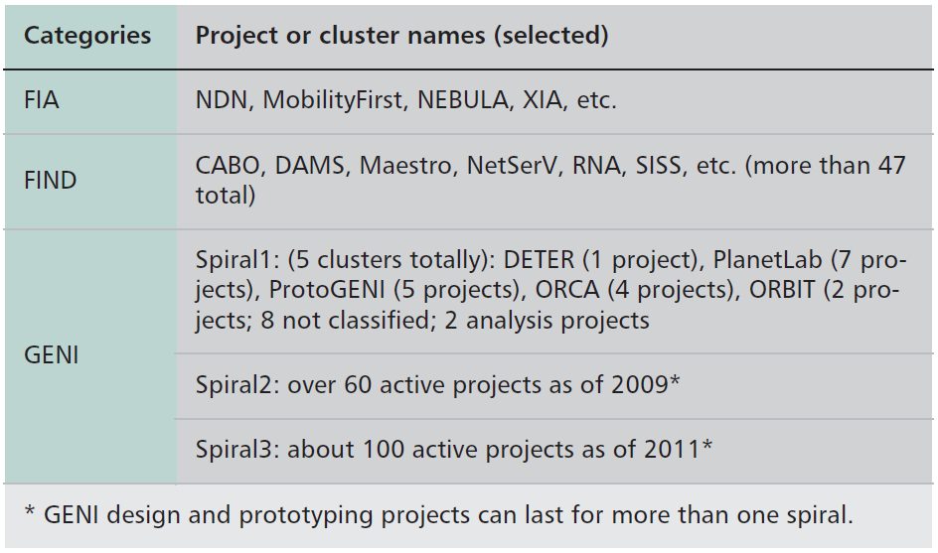
Research Projects from the US
Spiral4: outono 2011.
Spiral5: teve início no outono 2012.
Notes:
FIA e FIND programas da NSF
FIA is based on FIND
FIND: ~50 projects on all kinds of design aspects of FI
FIA: next phase to pull together the ideas into groups of overall architecture proposals.

Slide 10
NDN – Named Data Networking
UCLA + 10 universities and research institutes
Content Centric Model:
  The data are named instead of their location (IP addresses)
  Data become the first-class entities in NDN
  Instead of trying to secure the transmission channel or data path through encryption, NDN tries to secure the content by naming the data through a security-enhanced method.
    Separates trust in data from trust between hosts and servers.

Slide 11
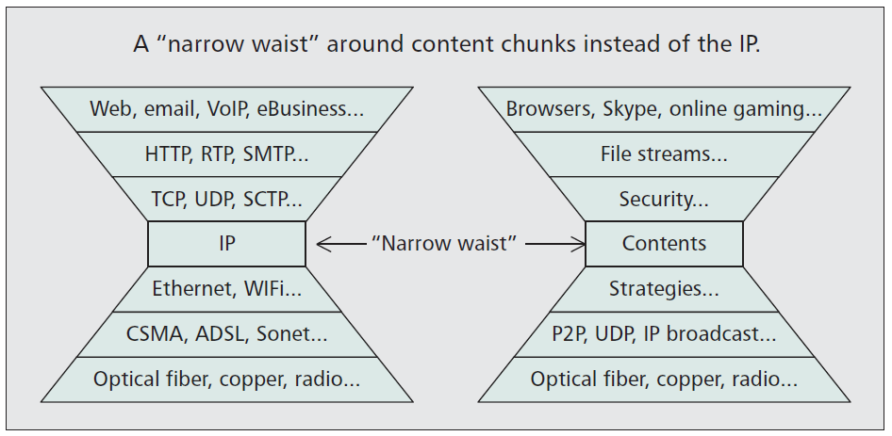
NDN – Named Data Networking

Slide 12
NDN Key Research Issues
How to find the data? Or How the data are named and organized to ensure fast data lookup and delivery?
  Name the content by a hierarchical “name tree” which is scalable and easy to retrieve
Data security and trustworthiness:
  The contents are signed by public keys
Scaling
  Names are longer than IP addresses, but the hierarchical structure helps the efficency of lookup and global accessibility of the data.

Slide 13
NDN – Other challenges
Routing scalability
Security and trust models
Fast data forwarding and delivery
Content protection and privacy
Underlying theory supporting the design

Slide 14
MobilityFirst
Rutgers + 7 universities
Basic Motivation:
  The current Internet fails to address the trend of dramatically increasing demands of mobile devices and services.
Short term goals:
  Addressing the cellular convergence
  Providing mobile p2p and infostation (DTN) application services.
Long term: V2V and V2I modes
  Location services, georouting, and reliable multicast.

Slide 15
MobilityFirst
Challenges:
  Stronger security and trust requirements
Targets a clean-slate design directly addressing mobility
  The fixed Internet will be a special case of the general design
“Narrow waist” around several protocols:
  Global name resolution and routing service
  Storage-aware (DTN-like) routing protocol
  Hop-by-hop segmented transport
  Service and Management APIs

Slide 16
MobilityFirst
The DTN-like routing protocol is integrated with the use of self-certifying public key addresses for inherent trustworthiness.
Context- and location-aware services fit into the architecture naturally

Slide 17
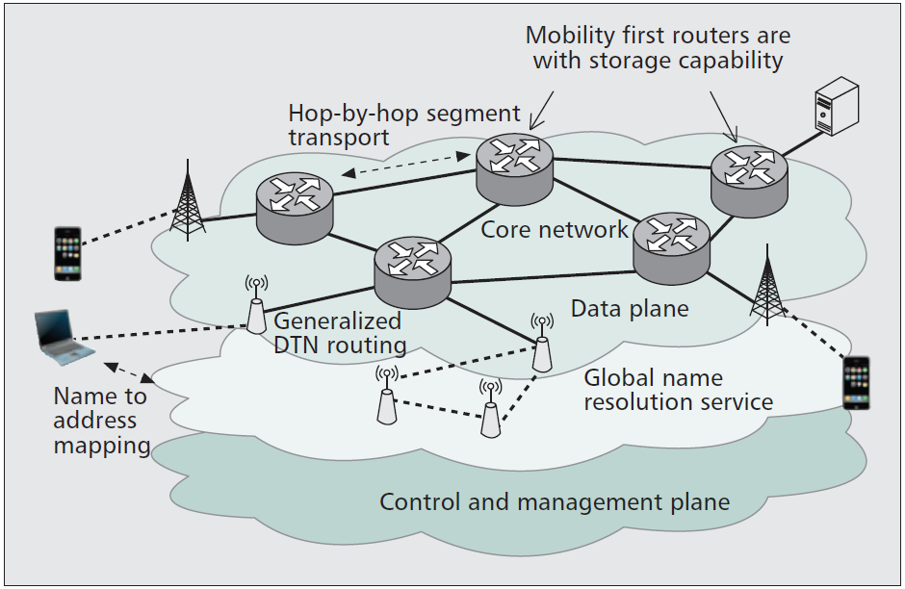
MobilityFirst Architecture

Slide 18
MobilityFirst
Typical research challenges:
  Trade-off between mobility and scalability
  Content caching and opportunistic data delivery
  Higher security and privacy requirements
  Robusteness and fault tolerance

Slide 19
NEBULA
University of Pennsylvania + 11 other universities
Cloud-computing-centric architecture.
  Highly available and extensible core network interconnecting data centers to provide utility-like services.
  Multiple cloud providers can use replication by themselves
  Mobile “roaming” users connect to the nearest data center with a variety of access mechanisms such as wired and wireless links.

Slide 20
NEBULA Design Principles
Reliabe and high-speed core interconnecting data centers
Parallel paths between data centers and core routers
Secure in both access and transit
A policy-based path selection mechanism
Authentication enforced during connection establishment

Slide 21
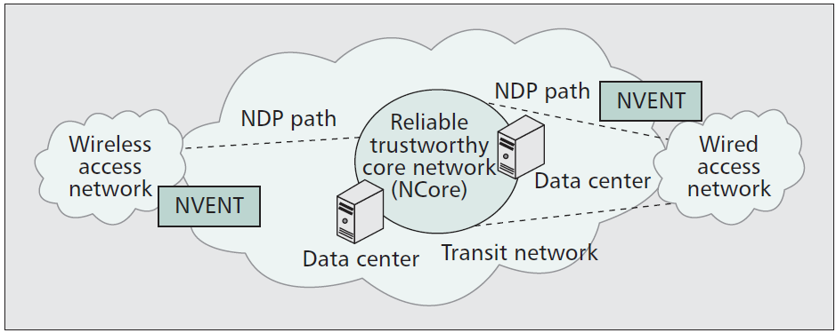
NEBULA FIA Key Parts
The NEBULA data plane (NDP)
NEBULA virtual and extensible networking techniques (NVENT)
The NEBULA core (Ncore)

Slide 22
eXpressive Internet Architecture (XIA)
Carnegie Mellon + 2 other universities
Directly and explicitly targets the security issue within its design

Slide 23
eXpressive Internet Architecture (XIA)
Key ideas:
  Define a rich set of building blocks or communication entities as network principals including hosts, services, contents, and future additional entities.
  It is embedded with intrinsic security by using self-certifying identifiers for all principals for integrity and accountability properties.
  A pervasive “narrow waist” (not limited to the host-based communication as in the current Internet) for all key functions, including access to principals, interaction among stakeholders, and trust management; it aims to provide interoperability at all levels in the system, not just packet forwarding.

Slide 24
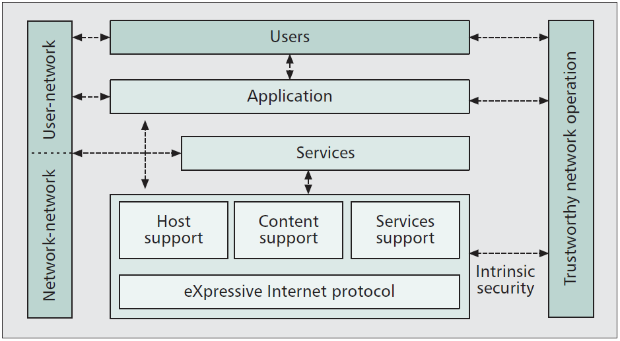
XIA components and interactions

Slide 25
GENI

Slide 26
GENI Key Pieces
Physical network substrates that are expandable building block components
A global control and management framework that assembles the building blocks together into a coherent facility

Slide 27
GENI generic control framework
Basic entities:
  Aggregate and components
  Clearinghouse
  Research organizations, including researchers and experiment tools
  Experiment support service
  “Opt-in” end users
  GENI operation and management

Slide 28
GENI Original Clusters
Cluster A: TIED – Trial Integration Environment based on DETER
Cluster B: CF based on PlanetLab
Cluster C: ProtoGENI
Cluster D: ORCA – Open Resource Control Architecture
Cluster E: ORBIT – Open-Access Research Testbed for Next-Generation Wireless Networks

Slide 29
Research Projects from the EU

Slide 30
FP7 Projects
Objective 1.1: Network of the Future
Clusters:
  “Future Internet Technologies (FI),”
  “Converged and Optical Networks (CaON),” and
  “Radio Access and Spectrum (RAS).”

Slide 31
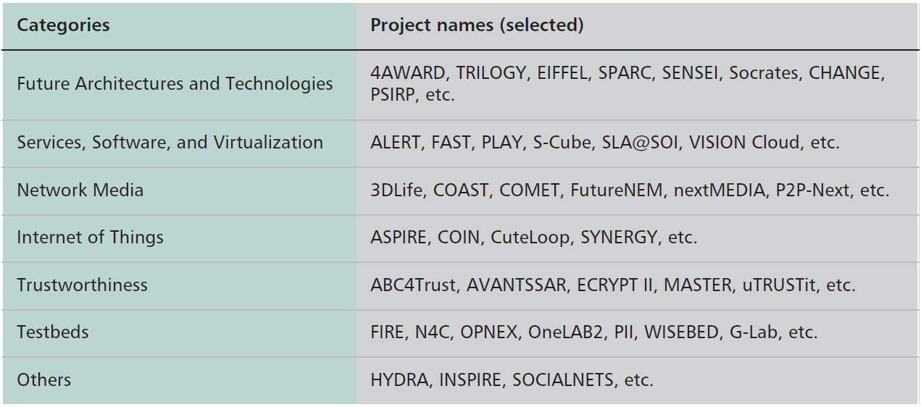
Research Projects from the EU
Notes:
FIA e FIND programas da NSF
FIA is based on FIND
FIND: ~50 projects on all kinds of design aspects of FI
FIA: next phase to pull together the ideas into groups of overall architecture proposals.

Slide 32
4WARD – Architecture and Design for the Future Internet
Led by an industry consortium
Design goals:
  To create a new “network of information” paradigm in which information objects have their own identity and do not need to be bound to hosts
  To design the network path to be an active unit that can control itself and provide resilience and failover, mobility, and secure data transmission
  To devise “default-on” management capability that is an intrinsic part of the network itself
  To provide dependable instantiation and interoperation of different networks on a single infrastructure.

Slide 33
4WARD Task Components
A general architecture and framework
Dynamic mechanisms for securely sharing resources in virtual networks
“Default-on” network management system; a communication path architecture with multipath and mobility support
Architecture for information-oriented networks

Slide 34
FIRE – Future Internet Research and Experimentation
Started a 4th wave in 2012.
Dimensions:
  To support long-term experimentally driven research on new paradigms and concepts and architectures for the future Internet
  To build a large-scale experimentation facility by gradually federating existing and future emerging testbeds
A major goal of FIRE is federation.

Slide 35
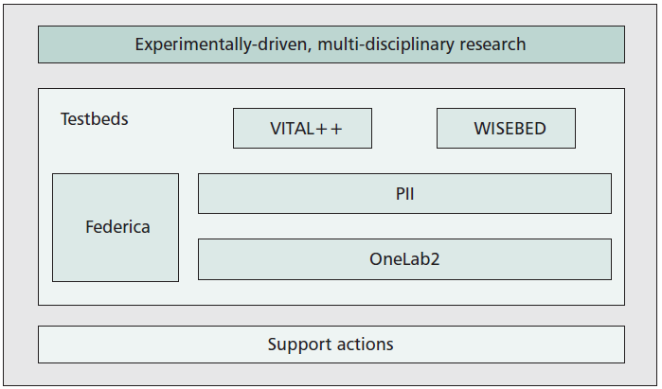
FIRE clustering of projects

Slide 36
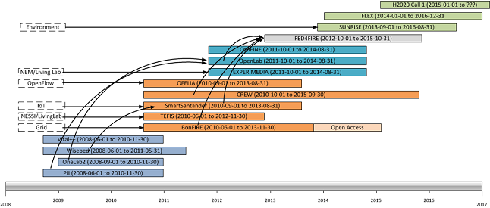
FIRE roadmap
Fonte: http://www.ict-fire.eu/home/fire-roadmap.html

Slide 37
Asia

Slide 38
Japan
NWGN – New Generation Network
Participates in PlanetLab and is federated with G-Lab
AKARI – FI Architecture
JGN2plus and JGN-X

Slide 39
AKARI
AKARI = “a small light in the darkness”
Clean-slate approach
Key design principles:
  “Crystal synthesis,” which means to keep the architecture design simple even when integrating different functions
  “Reality connected,” which separates the physical and logical structures
  “Sustainable and evolutional,” which means it should embed the “self-*” properties (self-organizing, self-distributed, self-emergent, etc.), and be flexible and open to the future changes

Slide 40
China
Research projects:
  New Generation Trustworthy Networks (from 2007 to 2010)
  New Generation Network Architectures (from 2009 to 2013)
  Future Internet Architectures (from 2011 to 2015)
Other projects:
  China Next Generation Internet (CNGI)
  IPv6 testbed

Slide 41
Discussions and Perspectives

Slide 42
Issues worth discussing
Clean-slate vs. Evolutionary
  While the architectures can be revolutionary, their implementation has to be evolutionary.
  Any architecture that requires investment without immediate payoff is bound to fail.
Integration of security, mobility, and other functionalities
Architectures built around people instead of machines

Slide 43
Issues worth discussing
Experimental facilities
Service delivery networks

