Slide 1
BirdVis: Visualizing and Understanding Bird Populations
Nivan Ferreira, Lauro Lins Juliana Freire, Cláudio Silva | Daniel Fink, Chris Wood Steve Kelling
Notes:
- Good morning
- Nivan Ferreira
- I’m going to talk about BirdVis
- Motivation on why this field is important

Slide 2
Contexto

Slide 3
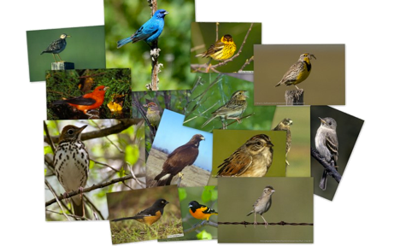
Birds
Provide a doorway into nature and scientific study
Birds are indicators of environmental health
Notes:
Birds are important
-Sensible
-Indicators of Environment Health
-Easy to observe
-Link to Roosevelt’s comment

Slide 4
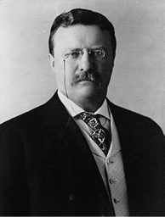
“Birds should be saved for utilitarian reasons; and, moreover, they should be saved because of reasons unconnected with dollars and cents... The extermination of the Passenger Pigeon meant that mankind was just so much poorer... the loss is like the loss of a gallery of the masterpieces of the artists of old time.”
—Theodore Roosevelt, 1916
Notes:
- Bird conservation was already a concern almost 100 years ago.
The problem got the attention of the president of the united states.

Slide 5
Notes:
Today it is still
there are many projects with this goal
the state of the birds
that contains results of research on the field of ornithology, results of conservation projects and set the goal to next years.

Slide 6
Notes:
One of the institutions that is part of the team of this big project is the Cornell Lab of Ornithology
To make a long story short

Slide 7
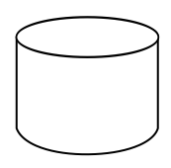
Biologists
Observation
Data
Notes:
Biologists with bird population data

Slide 8
Biologists
Statisticians
Modeling
Observation
Data
Results
Notes:
In collaboration with statistician they tried to use this data to create a model that would represent the bird population

Slide 9
Biologists
Statisticians
Modeling
Observation
Data
Results
Notes:
And they tried to analyze

Slide 10
Biologists
Statisticians
Modeling
Observation
Data
Results
CS & Vis
Notes:
- Validate Model
-

Slide 11
Biologists
Statisticians
Modeling
Observation
Data
Results

Slide 12
Dados

Slide 13
Biologists
Statisticians
Modeling
Observation
Data
Results

Slide 14
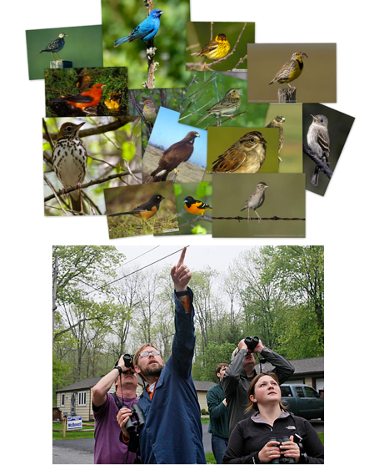
eBird Database
Launched in 2002 by CLO and National Audubon Society
Crowdsourcing database
Collected observations for over 90% of the world’s bird species

Slide 16
Bird Observations

Slide 17
Species
Number of Birds
Weather
Environment
Time

Slide 18
Biologists
Statisticians
Modeling
Observation
Data
Results

Slide 19
STEM
STEM (Spatiotemporal exploratory model) is a semi-parametric machine learning model based on Decision Trees
STEM produces bird occurrence estimations in large spatial and temporal scales using a multi-scale strategy

Slide 20
STEM
Decision Tree

Slide 21
STEM

Slide 22
STEM

Slide 23
STEM
Model
species
location
time

Slide 24
STEM
Model
species
occurrence probability
location
time

Slide 25
STEM
Model
species
occurrence probability
location
predictor importance
time

Slide 26
STEM
Model
species
occurrence probability
location
predictor importance
time
Barren Land | Evergreen Forest
Cultivated Crops | Grassland
Deciduous Forest | Ice Snow
Developed High | Mixed Forest
Developed Low | Open Water
Developed Med | Pasture
Developed Open | Shrub scrub
Emergent Wetlands | Woody Wetlands
Predictions for 2009
52 Predictions (one per week)
habitat preferences

Slide 27
Biologists
Statisticians
Model
Observation
Data
Results

Slide 28
Tarefas

Slide 29
Visualization Needs
Visualize migration patterns (What is the path birds follow?)
Compare the behavior of different species
Investigate predicted habitat preferences (Are model habitat preferences corresponding to prior knowledge?)

Slide 31
Interactive visualization tool spatiotemporal multivariate data
Collaboration with Cornell Lab of Ornithology
Developed closely with Biologists and Statisticians

Slide 32
O Sistema

Slide 33
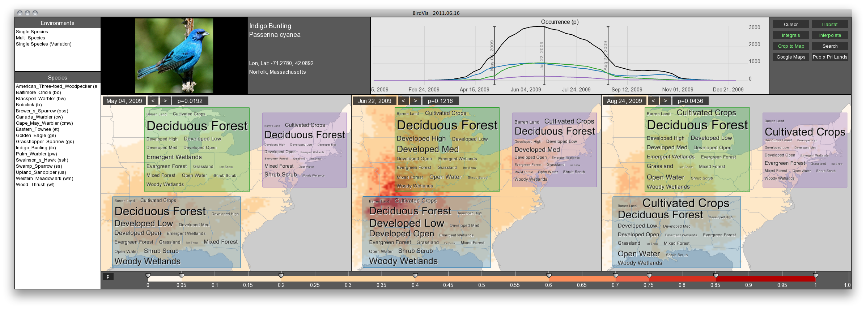

Slide 34
Design Decisions

Slide 35
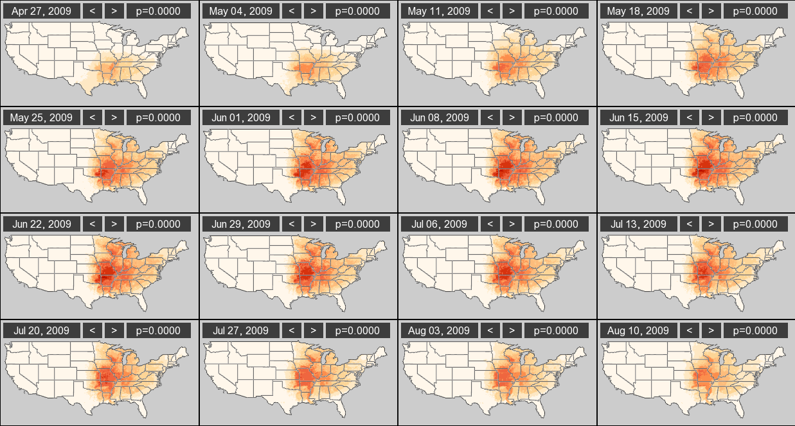
Design Decisions
Multiple Map Views

Slide 36
Design Decisions
Colormap Controller

Slide 37
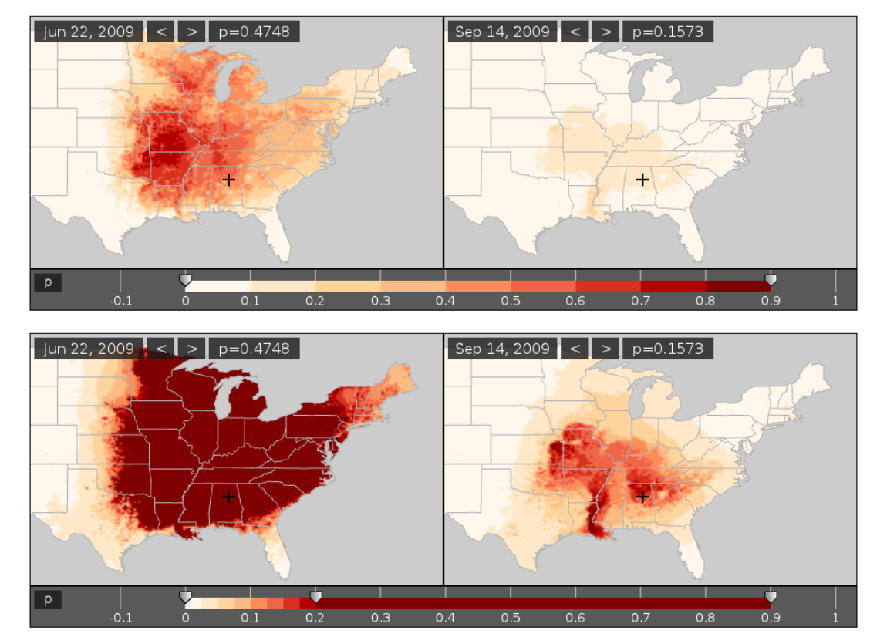
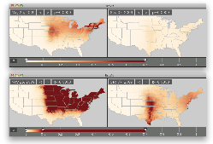
Design Decisions
Example of Different Colormap Configurations
Notes:
Remember: if we assume a simple sequential colormap (simple = 2 hues)

Slide 38
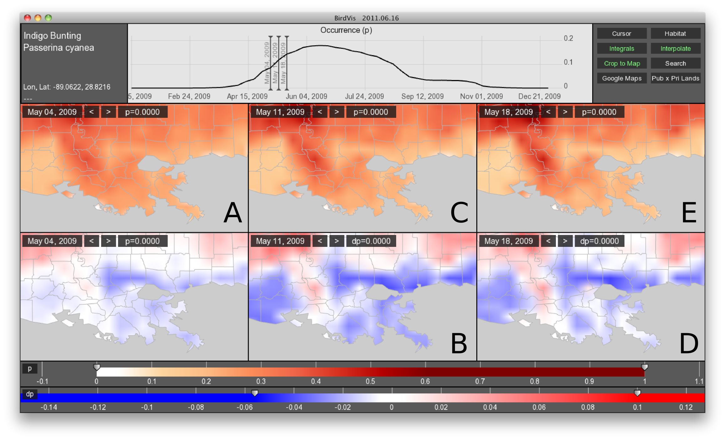
Visualizing Changes
Design Decisions
A + B = C C + D = E
Notes:
Remember: if we assume a simple sequential colormap (simple = 2 hues)

Slide 39
Putting all together

Slide 40
Palm Warbler Spring Migration

Slide 41
Predicted Habitat Preferences
Tag Cloud Lenses

Slide 42
Tag Cloud Lenses

Slide 43
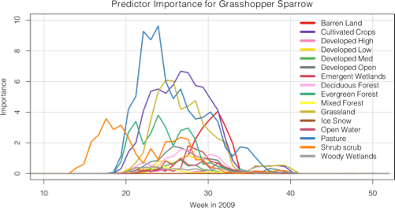
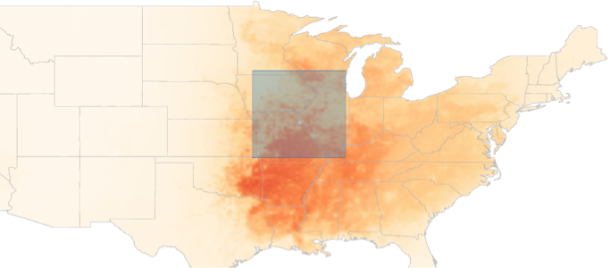

Slide 44
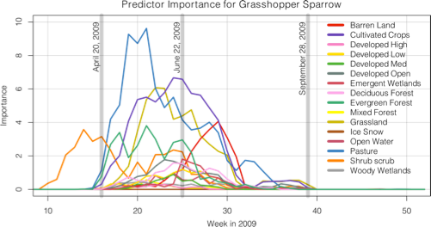
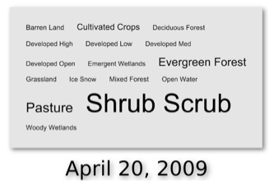
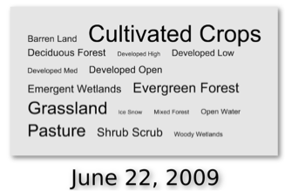
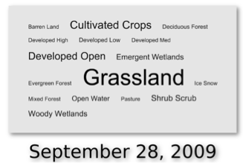

Slide 45
Tag Cloud
+ Magic Lenses
+ Coordinated Views =
Tag Cloud Lenses

Slide 46
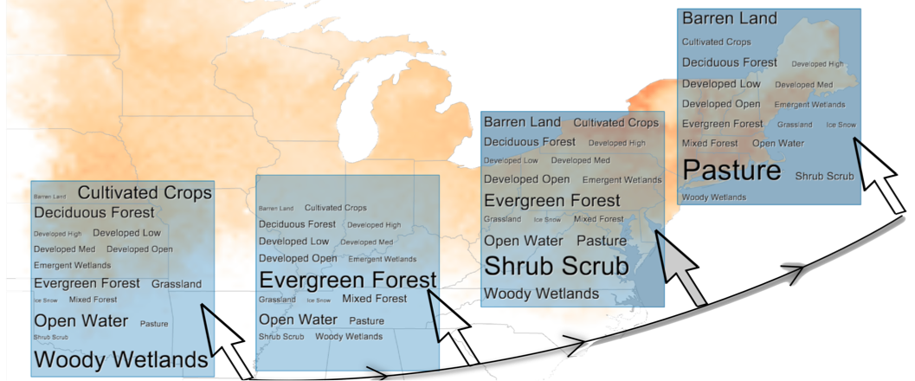
Tag Cloud Lenses
Spatial Exploration

Slide 47
Tag Cloud Lenses
Spatiotemporal Exploration

Slide 48
Visualizing Multiple Species

Slide 49
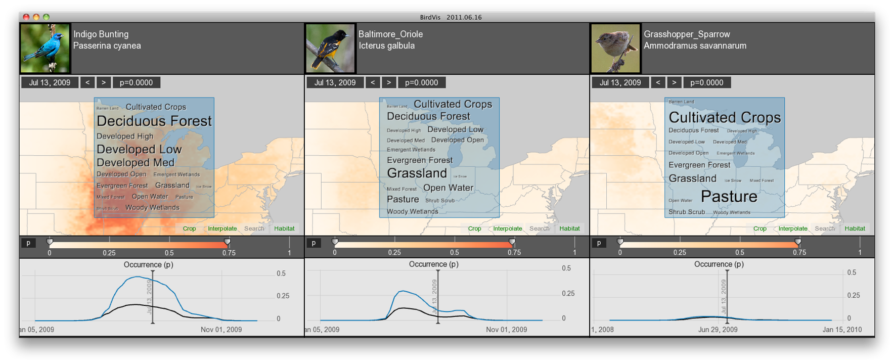
Multiple Species

Slide 50
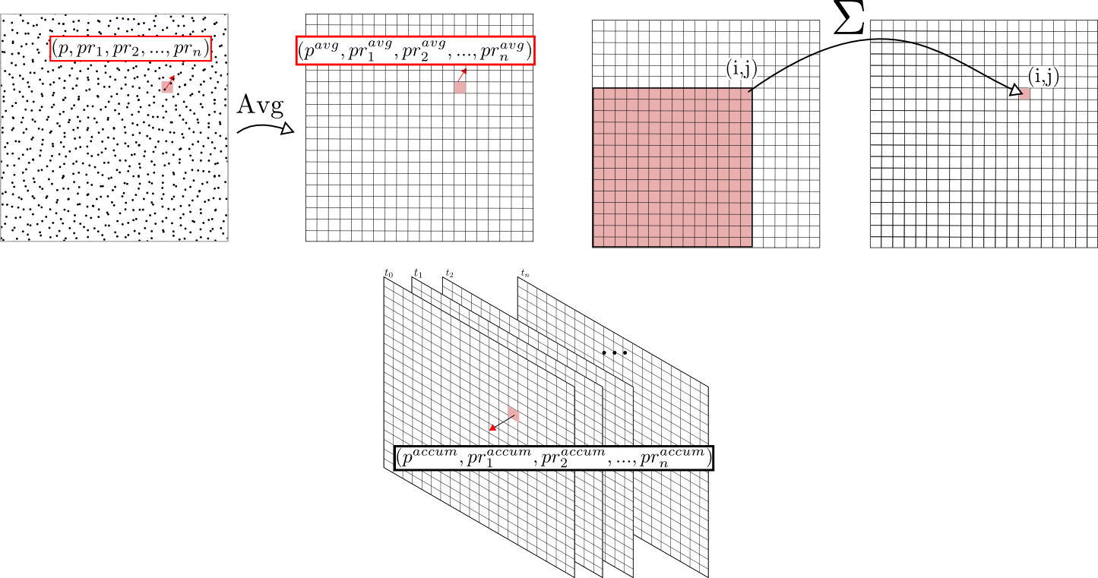
Data Storage

Slide 51
Results
Please find attached a screenshot of BirdVis showing the fall migration of Baltimore Oriole that got me so excited… BirdVis exploration seems to make you wonder if the eastern birds are flying over the Atlantic to the Caribbean and FL? while the central population heads due south to Central America. Pretty cool, since this is the first bird I looked at.
Notes:
I’d like to give you some of the impressions of our collaborators.
All our collaborators were Mac users except by one. This one happened to be the head of the group.
Since we used to callaborate more with the other members of the group we built a version of BV on
Mac and sent them to test. In one of the most recent versions we received a email of the head of the group.
The email was...

Slide 52
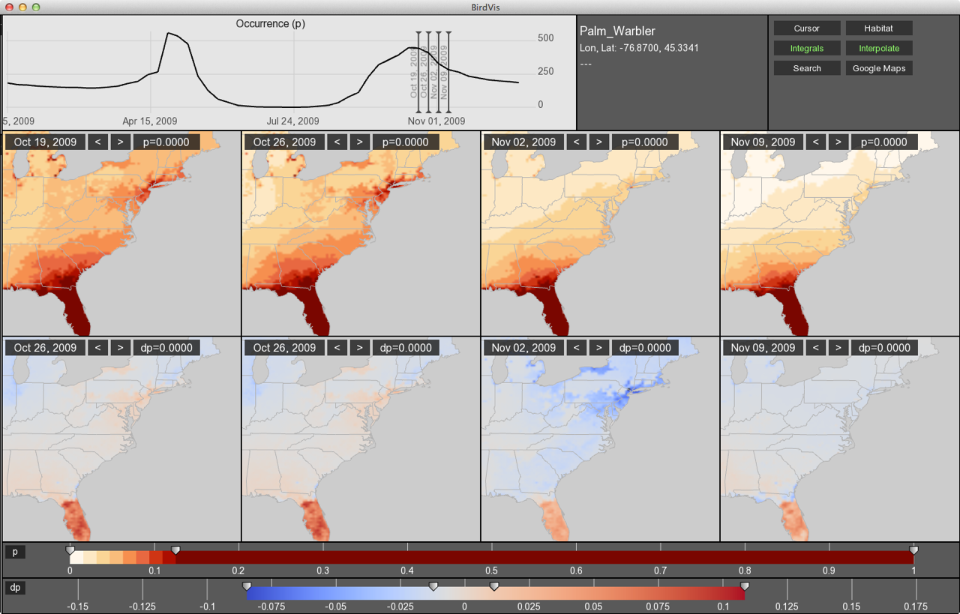
Results
Notes:
I’d like to give you some of the impressions of our collaborators.
All our collaborators were Mac users except by one. This one happened to be the head of the group.
Since we used to callaborate more with the other members of the group we built a version of BV on
Mac and sent them to test. In one of the most recent versions we received a email of the head of the group.
The email was...

Slide 53
Results
This is really really cool. We should do a systematic search for this pattern in other species. My prediction is that it will crop up time and time again for species traditionally thought to be "Trans Gulf" that actually have a "Trans-Atlantic" component too. I think we could do a really great paper on this topic alone... I think we can make a strong case using observational data alone that this is a pattern shown by much more than just Blackpoll Warbler (which some skeptics still do not believe).
Exciting!
Notes:
I’d like to give you some of the impressions of our collaborators.
All our collaborators were Mac users except by one. This one happened to be the head of the group.
Since we used to callaborate more with the other members of the group we built a version of BV on
Mac and sent them to test. In one of the most recent versions we received a email of the head of the group.
The email was...

